Slide 1
Regional Transportation Indicators - Progress
Presented May 26, 2010
by Tom Murtha
Senior Planner,
tmurtha@cmap.illinois.gov

Slide 2
Regional Indicators
2007: 2030 Regional Transportation Plan Performance Measures
2008: Indicators Identified and Approved
2008-2010: Developing Data Warehouse
2010: Developing Regional Transportation Data Archive

Slide 3
Regional Indicators
Previous Presentations of Analyses of Highway Roughness; Bridge Conditions; VMT Trends
Completing Major Analysis of Mode Share Using Travel Tracker data
Key Point: Transportation Indicators Integrated within Congestion Management Process: Emphasis on Analysis
Key Point: Integration of Indicators into Implementation of GO TO 2040
Key Point: Continuous Communication with Partners

Slide 4
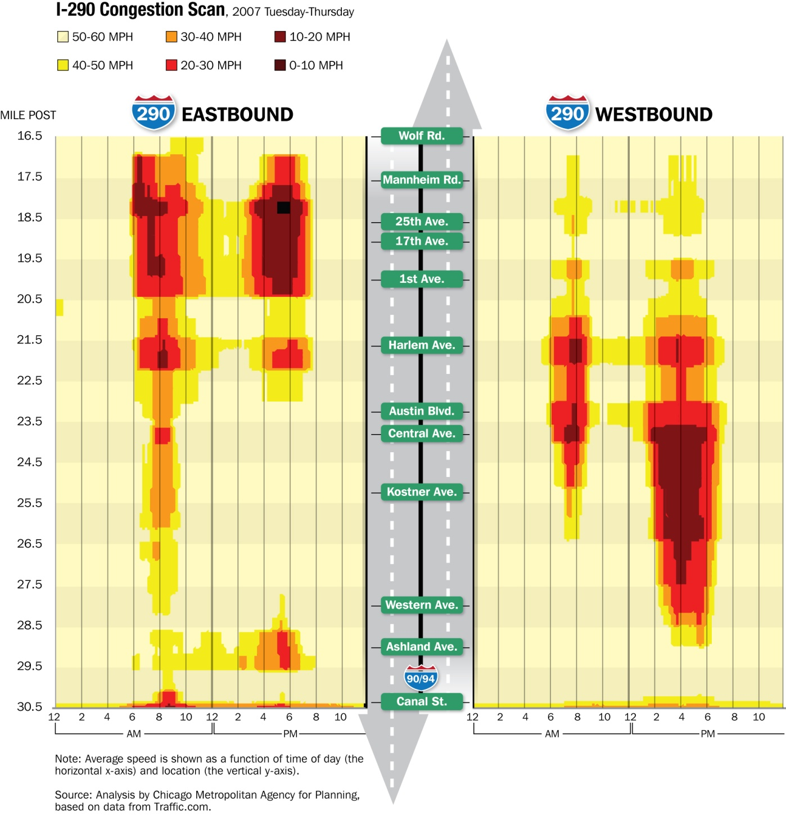
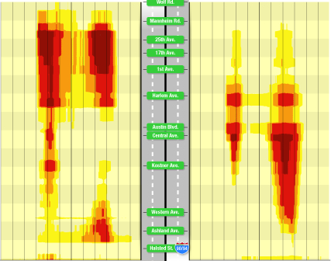
Freeway Performance: Eisenhower
2007
2009

Slide 5
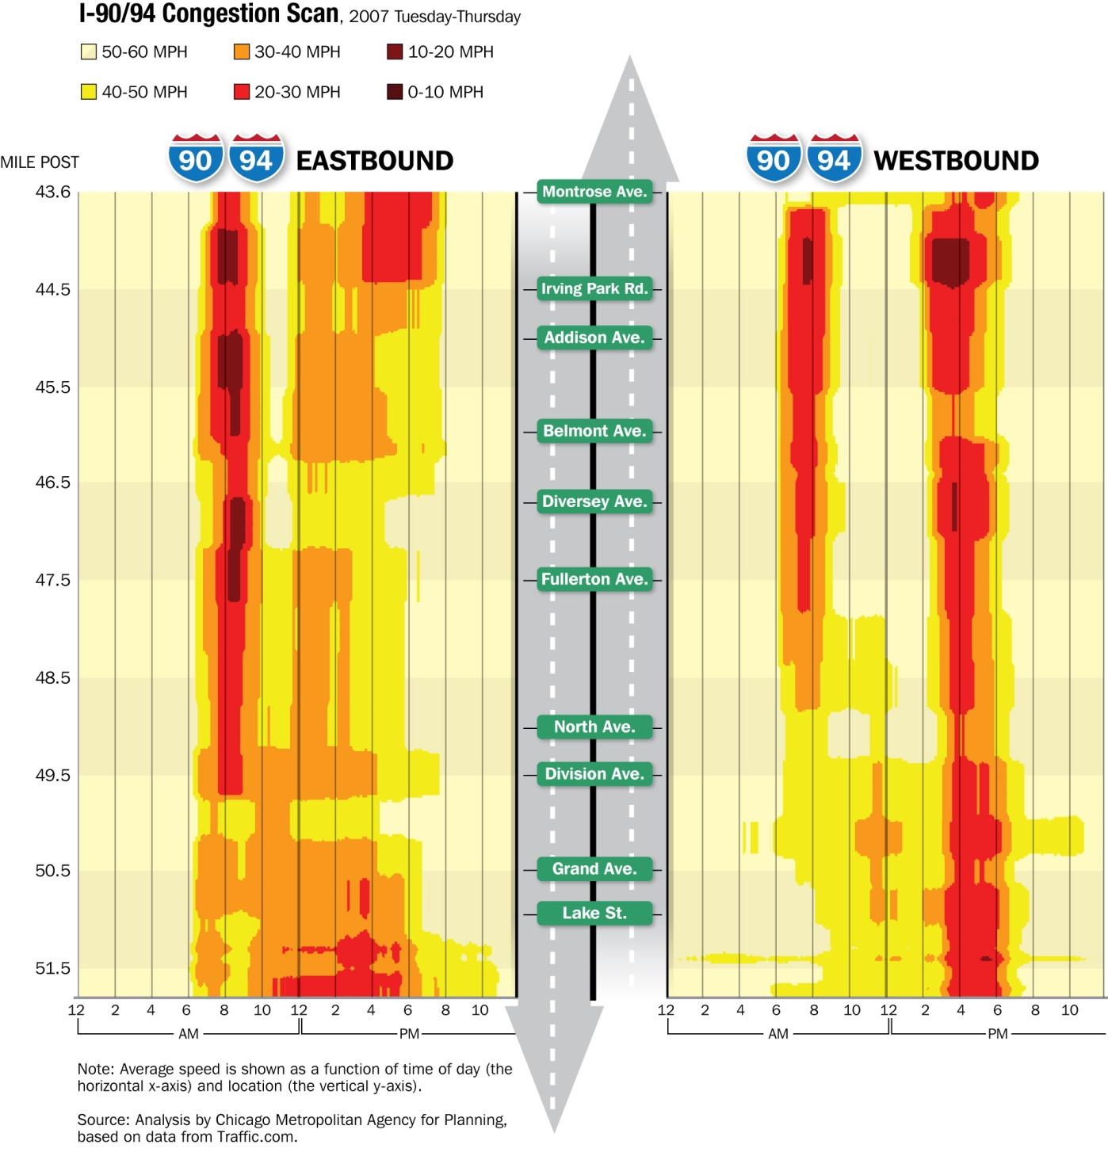
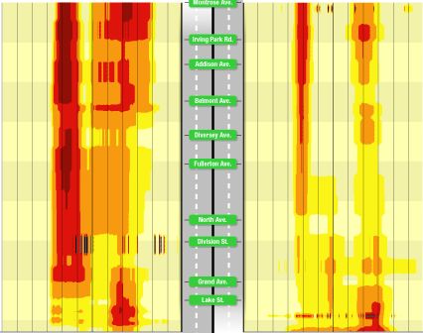
Freeway Performance: Kennedy
2007
2009

Slide 6
Freeway Segments: Highest Levels of Peak-Period Congestion*
AM Peak, 2009:
I-90/94 Reversibles from Montrose to Ogden (EB AM TTI 3.00)
I-90/94 Locals from I-94/Edens Expy to I-290 (EB AM TTI 2.89)
I-90 from I-190 to I-94 / Edens (EB AM TTI 2.41)
I-290 Ike from Wolf to Canal (EB AM TTI 2.32)
I-90 from I-94/Edens to I-190 (WB AM TTI 2.17)
PM Peak, 2009:
I-90 from I-190 to I-94 / Edens (EB PM TTI 3.56)
I-290 Ike from Wolf to Canal (EB PM TTI 2.48)
I-94/Edens from Deerfield Road to I-90/Kennedy (EB PM TTI 2.37)
I-290 Ike from Canal to Wolf (WB PM TTI 2.31)
I-90 from I-94/Edens to I-190 (WB PM TTI 2.04)

Slide 7
Freeway Segments: Changes in Peak-Period Congestion*
Fastest Reductions – ‘07-’09:
I-294 from I-55 to I-90 (NB AM TTI 1.77 to 1.14) (SB PM TTI 1.52 to 1.07)
I-190 from I-90 to Chicago O’Hare Int. Airport (EB PM TTI 2.10 to 1.49)
I-90/94 Locals from I-290 to I-94/Edens Expy (WB PM TTI 2.51 to 1.87)
I-355 from I-55 to I-88 (NB AM TTI 1.63 to 1.22)
Fastest Increases – ‘07-’09:
I-90/94 Locals from I-94/Edens Expy to I-290 (EB AM TTI 2.28 to 2.89)
I-90/94 Reversibles from Montrose to Ogden (EB AM TTI 2.38 to 3.00)
I-90/94 Locals from I-94/Edens Expy to I-290 (EB PM TTI 1.81 to 2.01)
I-57 from I-94 to I-80 (SB PM TTI 1.76 to 1.84)

Slide 9
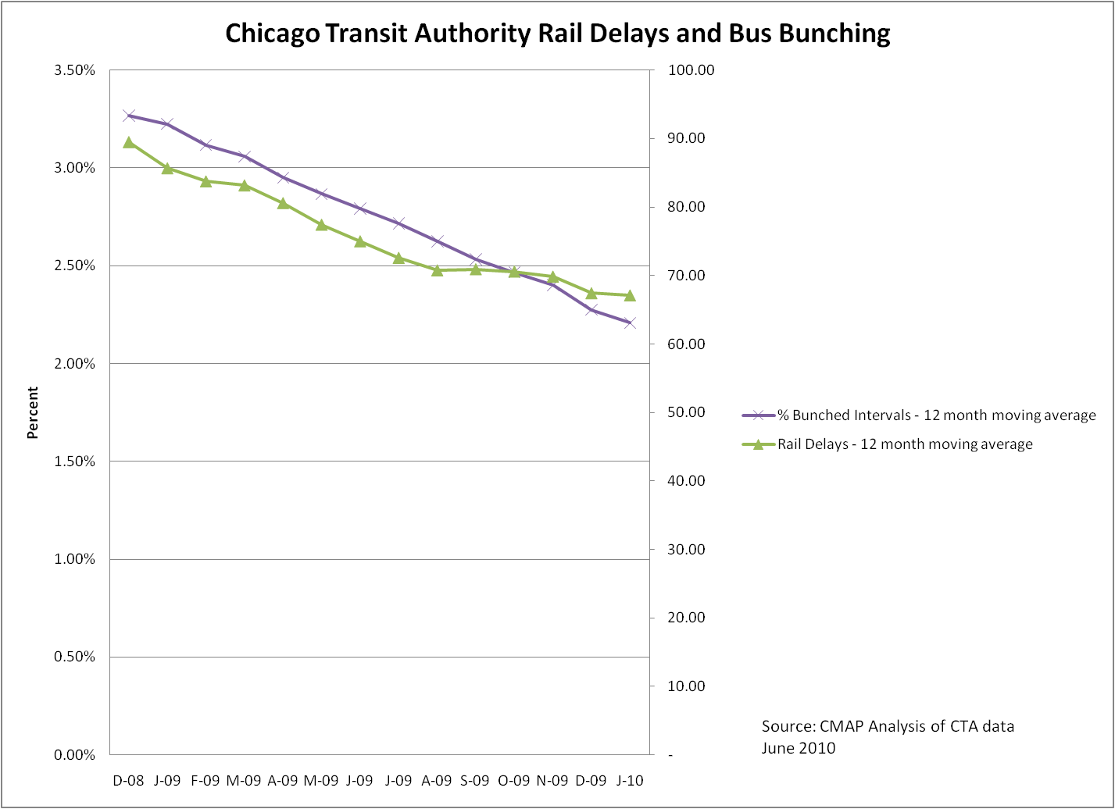
On-Time Performance - CTA

Slide 10
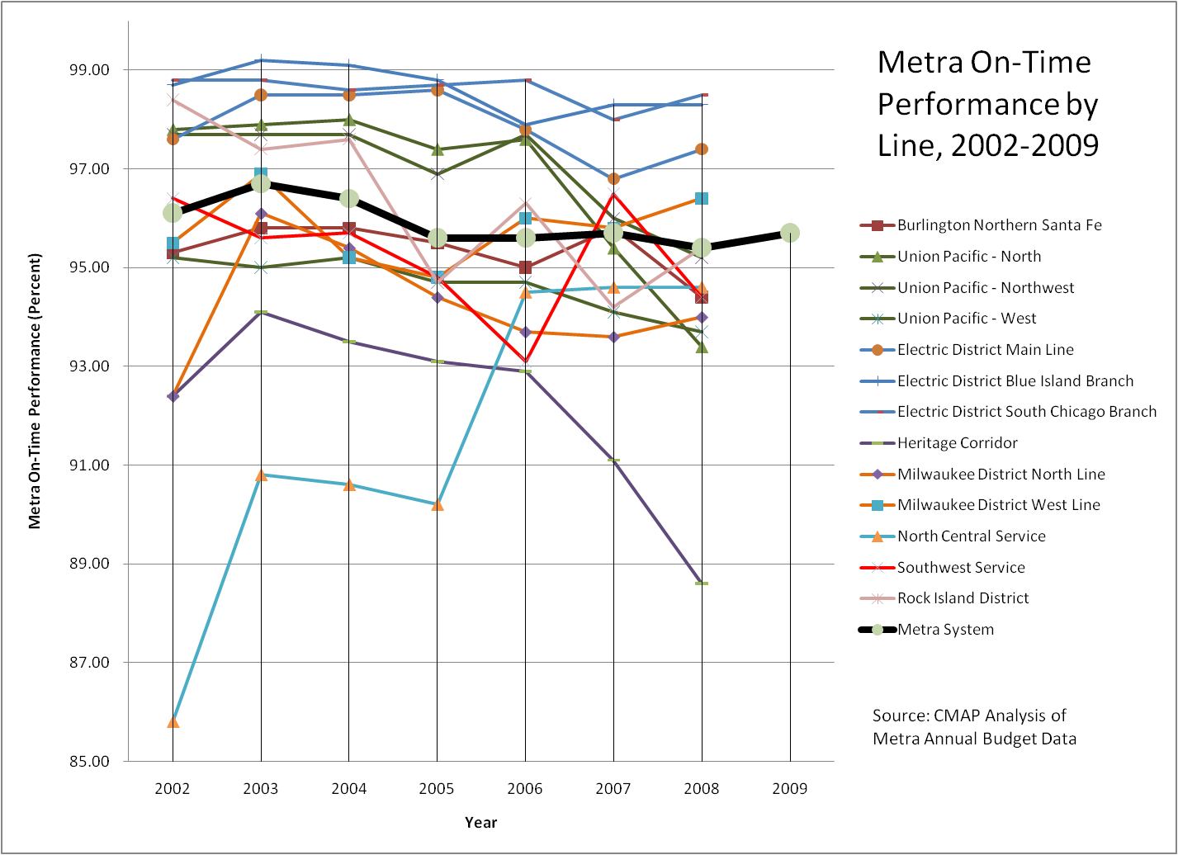

Slide 11
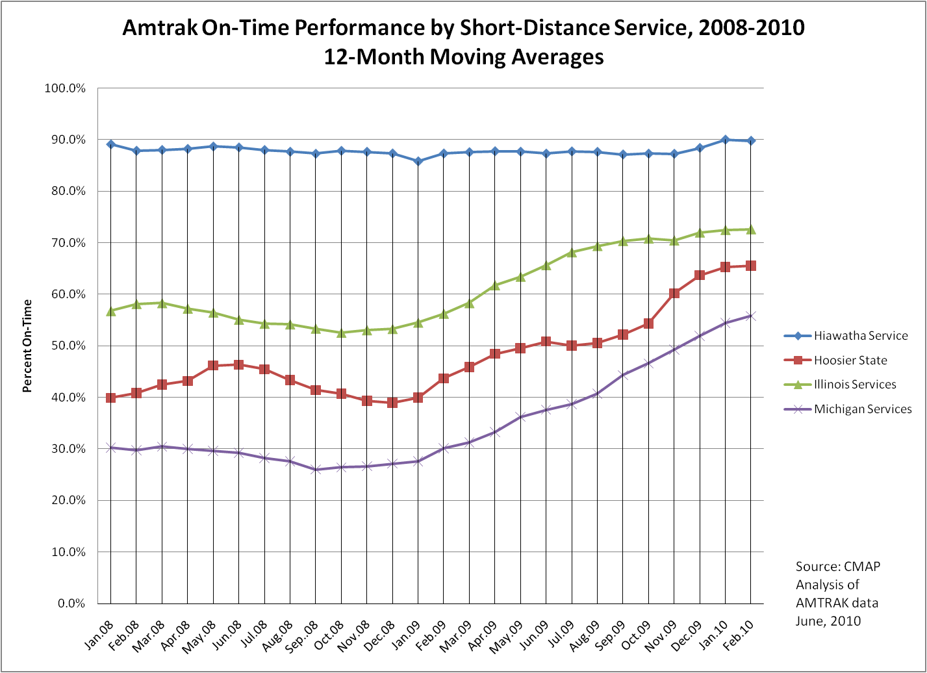

Slide 12
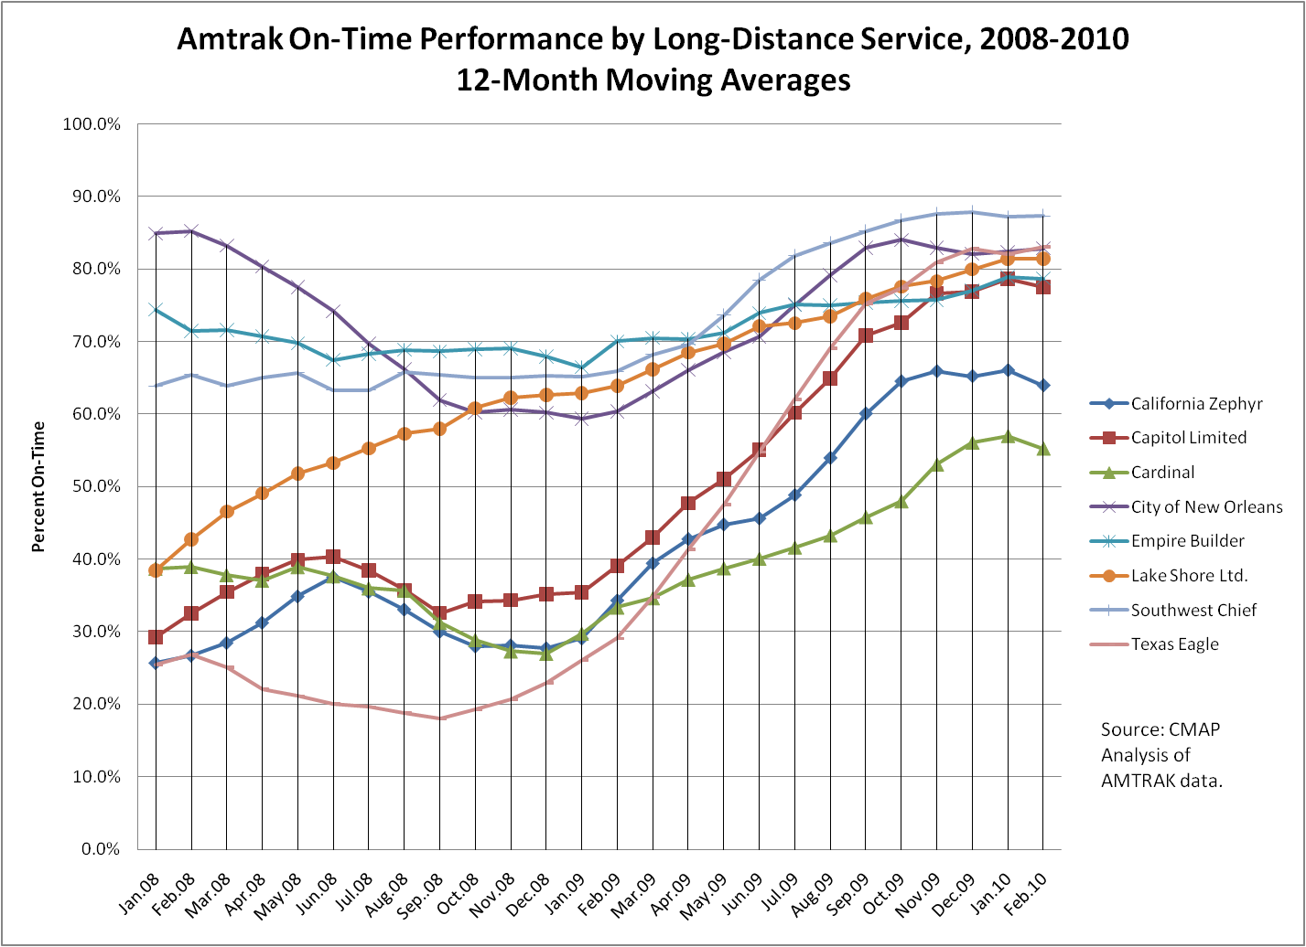

Slide 13
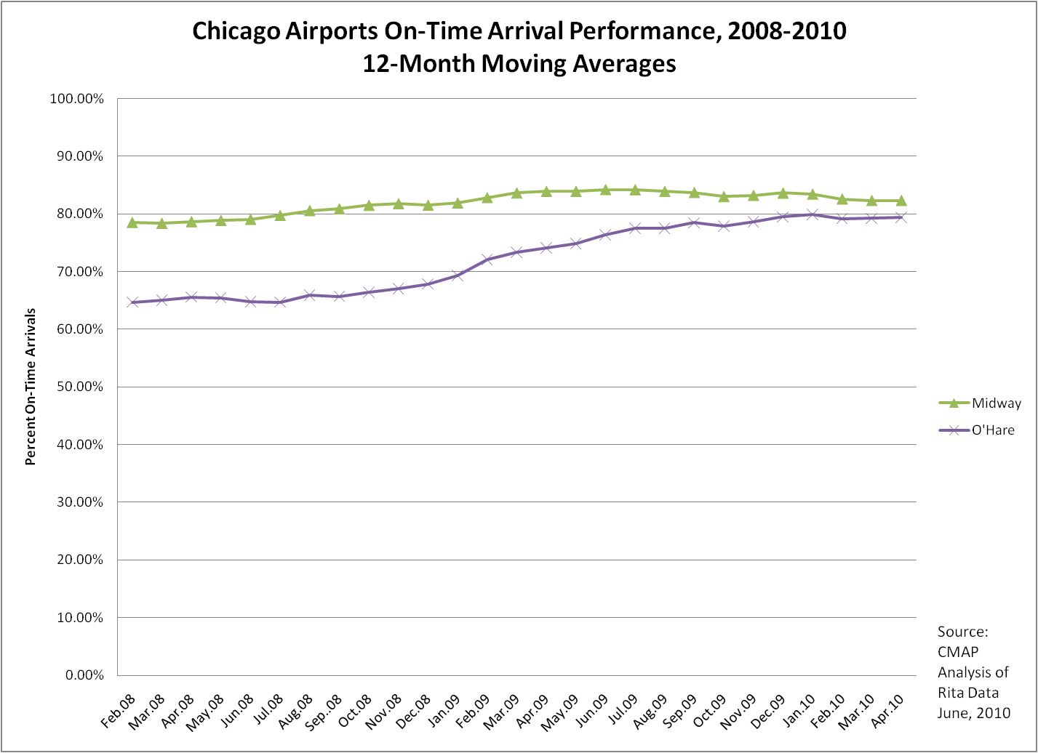

Slide 14
Regional Transportation Indicators - Progress
CMAP Contact:
Tom Murtha
tmurtha@cmap.illinois.gov
312-386-8790
Thank You

