Slide 1
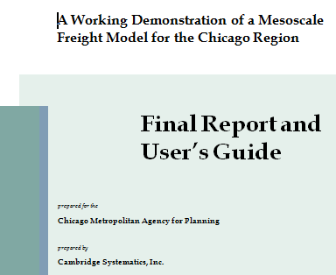
Kermit Wies
CMAP
September, 2011

Slide 2
CMAP’s Mesoscale Freight Model predicts how freight moves into, through and out from the region.
The middle section of our 3-tiered Freight construct
Meso
micro
Macro

Slide 3
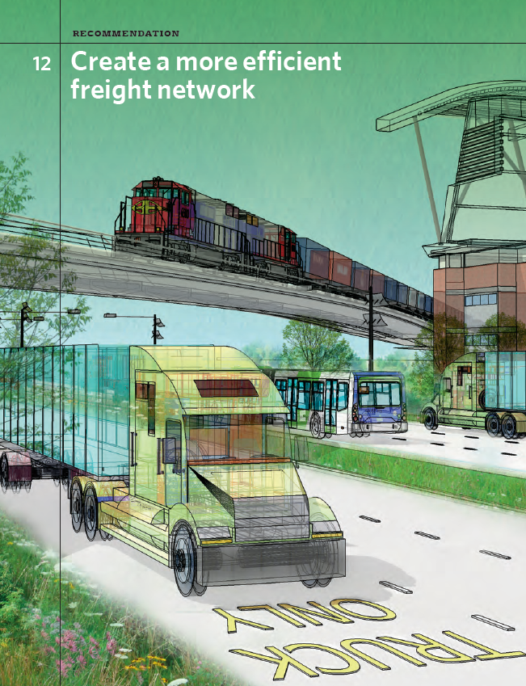
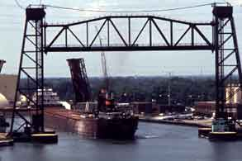
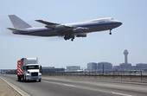
Why did we develop the Mesoscale Freight Model?
Our current model estimates only trucks based on observed counts
GO TO 2040 requires a freight modeling tool that explains
the economic choices made for goods movement across multiple modes and commodities

Slide 4
How does the Mesoscale Freight Model work?
Shippers
Receivers
Commodities
Receivers
Industry
Manufacture Leather Products
1-10
10-100
Location
Harvey
Maywood
>100
Aurora
Wauconda
Size
For each Firm
Commodities Transported
Select Suppliers
Top 5 Supply Industries
Firm Generation
Supplier Selection
Flow Apportionment
Path Selection
Commodities
Shippers
Products
Receivers
Path
Mode
Logistics
Distance
Size
Total annual logistics costs (G) (by commodity type) =
order costs (O)
+ transport and intermediate handling costs (T)
+ deterioration and damage costs (D)
+ capital costs of goods during transit (pipeline costs Y)
+ inventory costs (I)
+ capital costs of inventory (K)
+ stockout costs (Z)

Slide 5
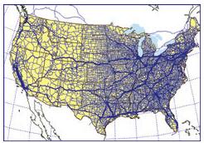
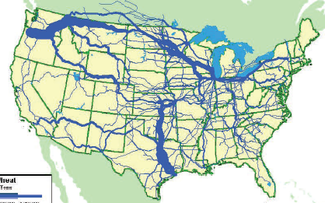
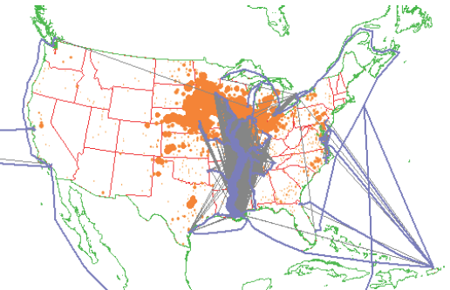
What data does the Mesoscale Freight Model need?
Commodity Flows
Make and Use Tables
County Business Patterns
Regional Employment Data
Rail, Highway, Air and Marine Networks

Slide 6
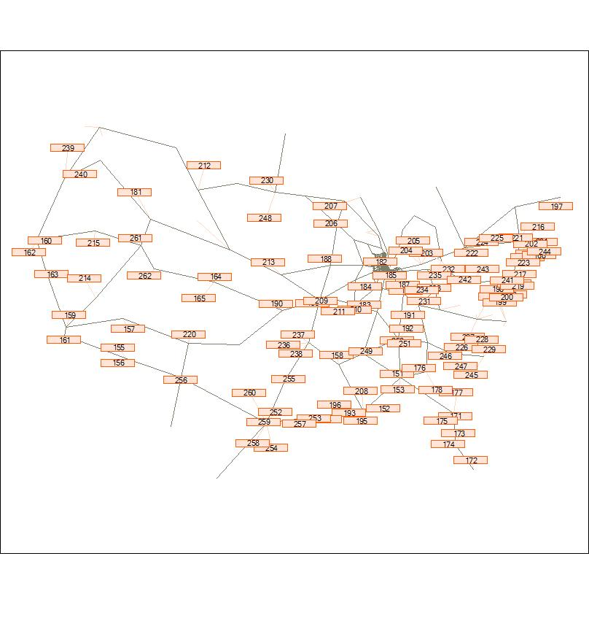
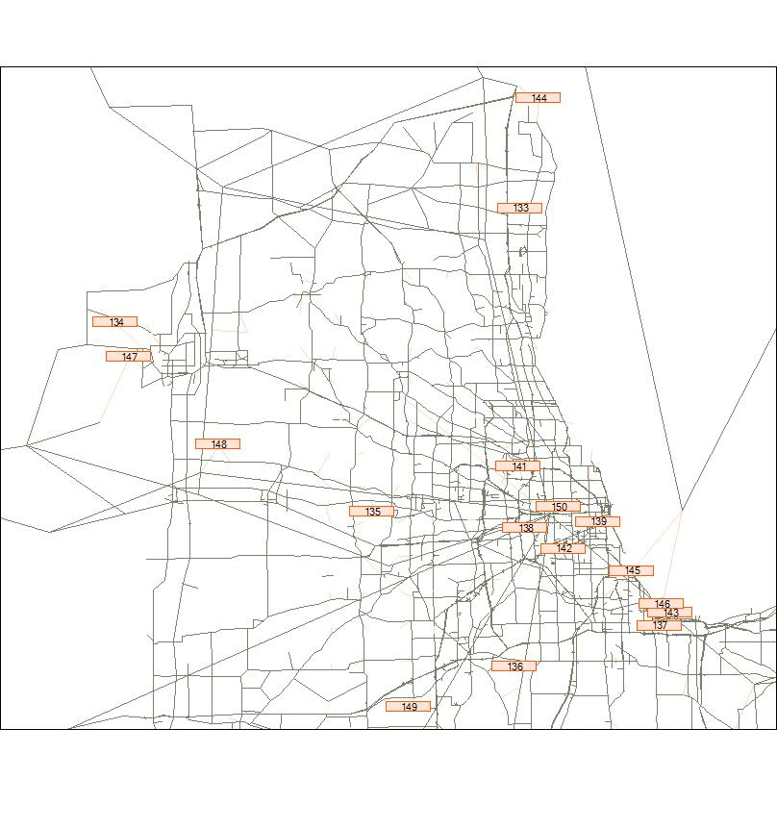
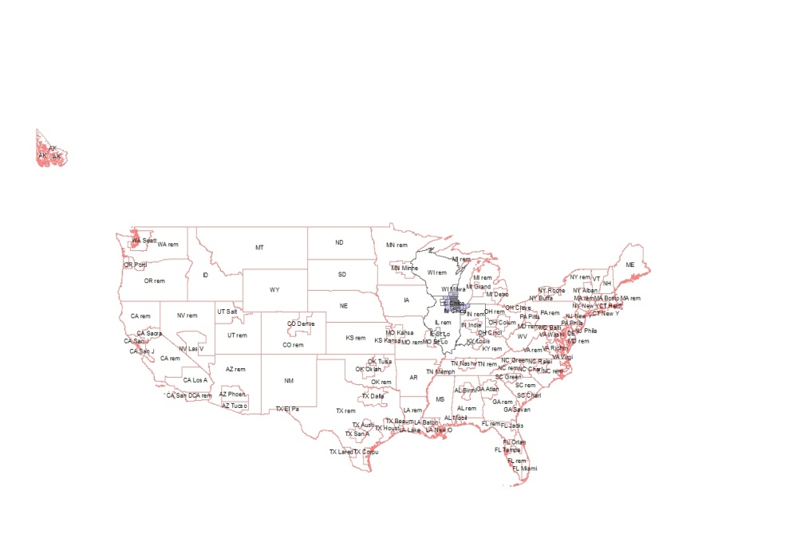
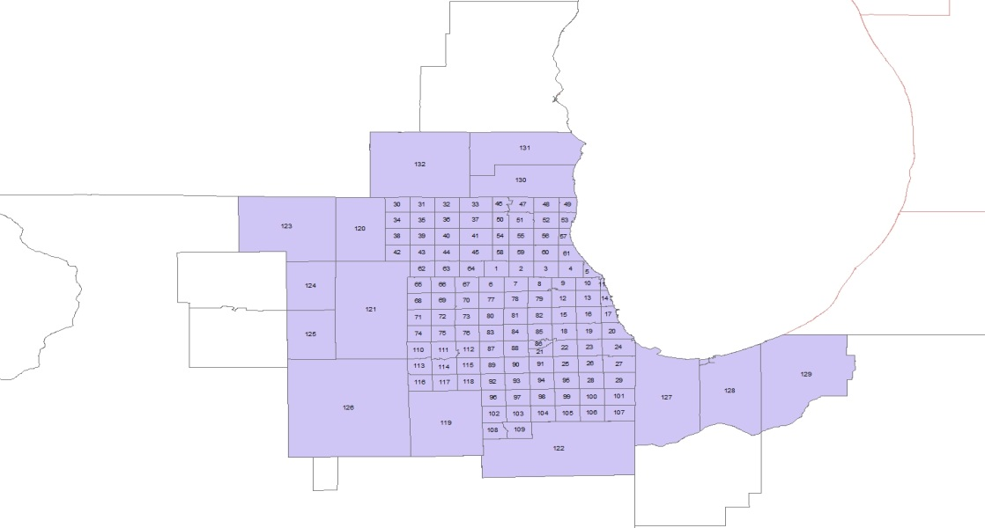
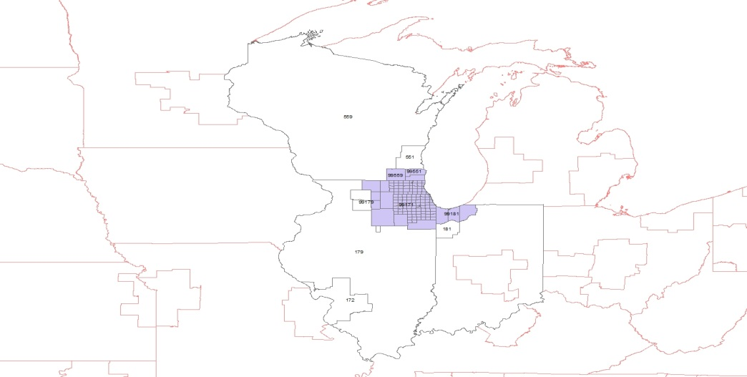
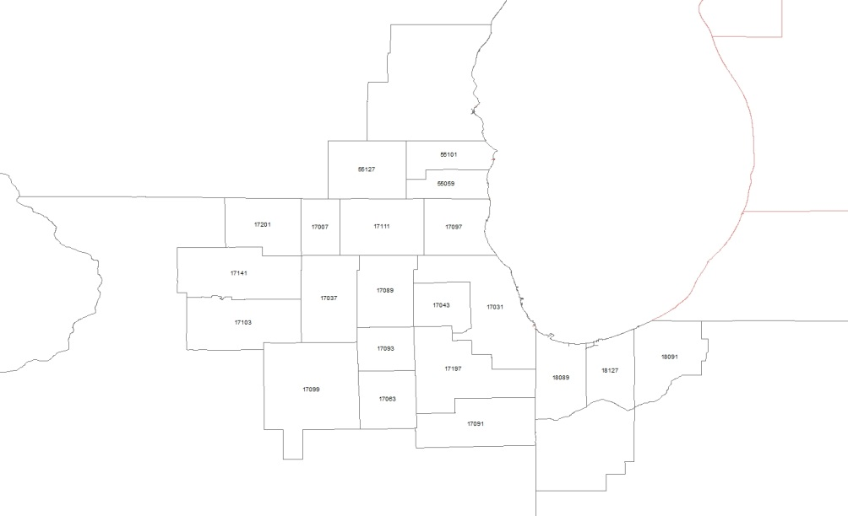
What does the Mesoscale Freight Model do?
Tracks individual firms and transactions
Commodity Flows
Logistics Details
40,000 Suppliers
691,000 Buyers
2,100,000 Shipper-Receiver Pairs
Live animals/fish
Cereal grains
Other ag prods.
Animal feed
Meat/seafood
Milled grain prods.
Other foodstuffs
Alcoholic beverages
Tobacco prods.
Building stone
Natural sands
Gravel
Nonmetallic minerals
Metallic ores
Coal
Crude petroleum
Gasoline
Fuel oils
Coal-n.e.c.
Basic chemicals
Pharmaceuticals
Fertilizers
Chemical prods.
Plastics/rubber
Logs
Wood prods.
Newsprint/paper
Paper articles
Printed prods.
Textiles/leather
Nonmetal min. prods.
43 Commodities
55 Logistics Alternatives

Slide 7
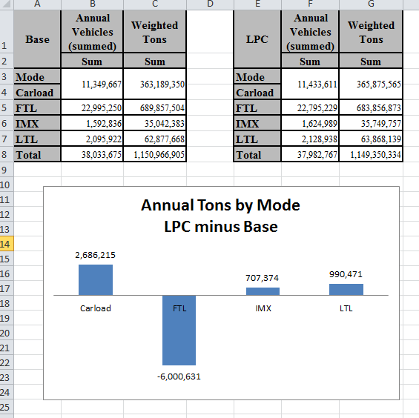
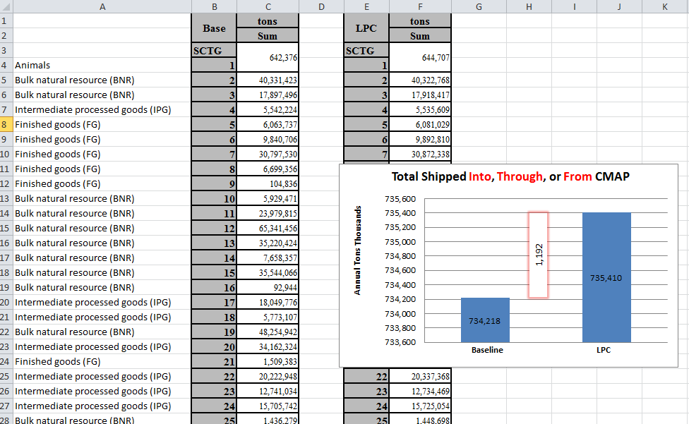
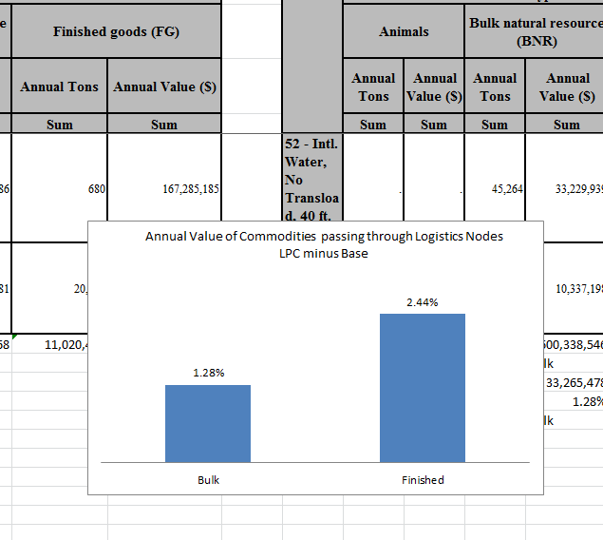
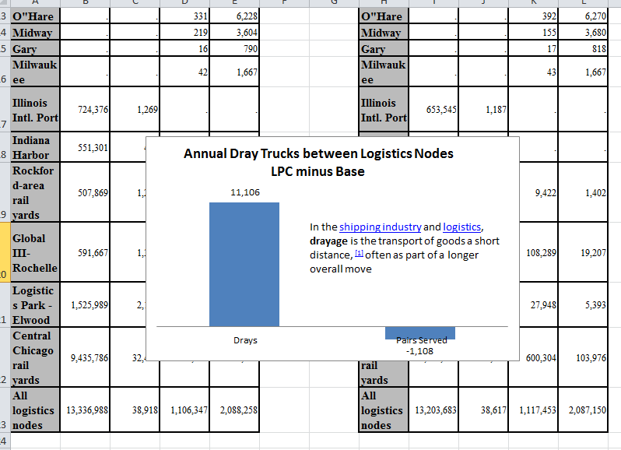
What does the MesoScale Freight Model tell us?
The effects of different scenarios.
For example:
Logistics Park Calumet
Model
The
Run
How?
Add a logistics node at the LPC location
Activate a short line RR between nearby railyards and water ports

Slide 8
FY12 Freight Modeling Priorities
Evaluate Freight Scenarios
GO TO 2040 Policies: Truck pricing, Brownfield redevelopment (COD), CREATE
Freight System: Combined Infrastructure Recommendations (CS).
Freight MacroModel Development
Permits MesoModel to be used in forecasting
Data development for MesoModel
Permits MesoModel to be calibrated and validated
Goal: incorporate into CMAP production models
Staff
Consultant
Staff and Consultant

