Slide 1

Stormwater Management Planning
& Resiliency
May 13, 2015

Slide 2
Stormwater Management and Flooding
Despite county-level stormwater management ordinances, urban flooding and damage continues in the region
  Between 2007-2011, 181,000 flood damage and sewer backup claims were made across 97 percent of Cook County totaling $773 million (CNT, 2014)
  Claims do not correlate with floodplains, i.e., flood insurance covers only 8% of payouts, disaster recovery covers the majority (CNT, 2014)
Older neighborhoods and vulnerable populations are particularly susceptible
Solutions can be complex and expensive
Existing and developing urban landscapes coupled with potential changes to climate dynamics could make the problem worse
Notes:
(Source: DCEO study Building Successful Food Hubs) … huge unmet demand – over $10 B to be kept in-state if we produced more fruit and veg.

Slide 3
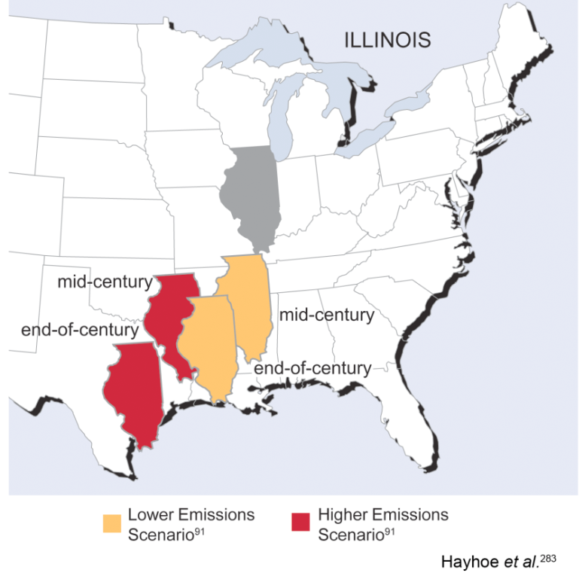
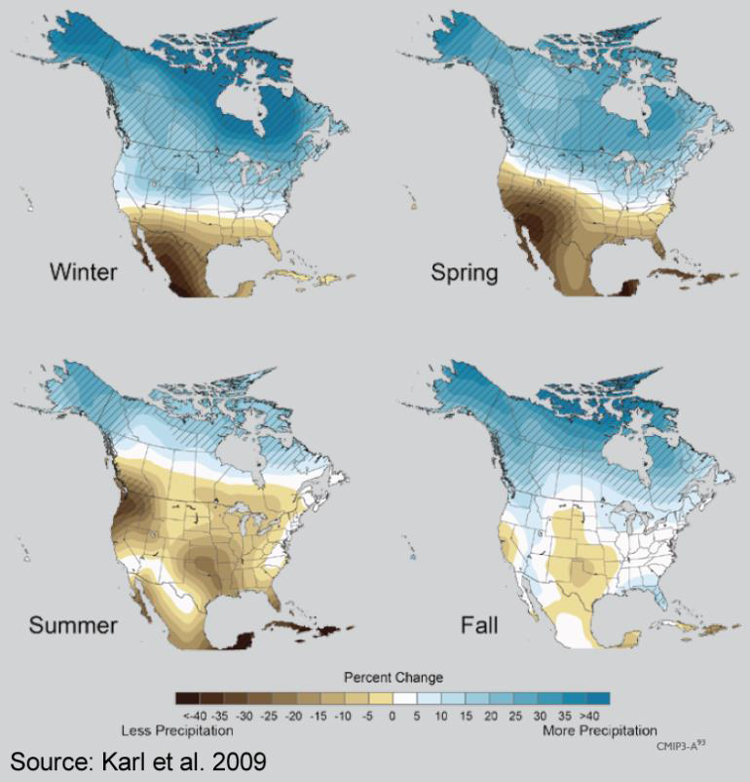
Climate model predictions
“All models are wrong; some models are useful.” – George E.P. Box
Summers considerably warmer but less summertime precipitation
Lower Lake Michigan water levels
Increased precipitation during winter and spring
Precipitation events as heavy downpours
Longer growing season, but more heat waves, floods, droughts, insects, and weeds
Plant zone / native species shifts
(Information based on over a dozen climate models used to predict for the Midwest by the International Panel on Climate Change. Douglas Sisterson, Environmental Science Division, Argonne National Laboratory)
Notes:
(Source: DCEO study Building Successful Food Hubs) … huge unmet demand – over $10 B to be kept in-state if we produced more fruit and veg.

Slide 4
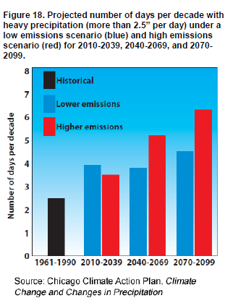
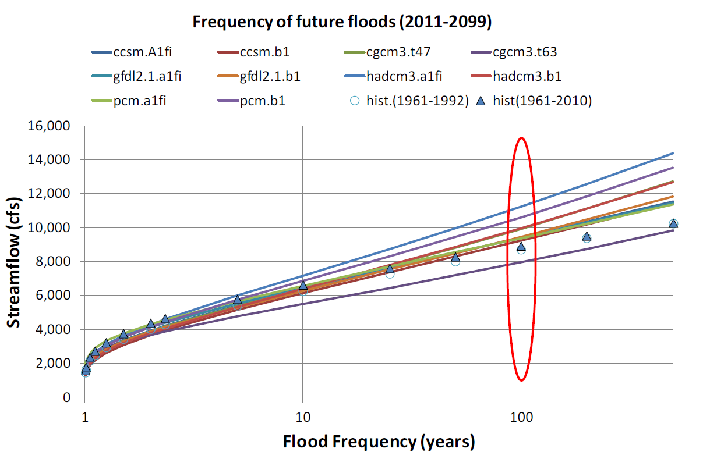
Climate ‘disruption’ flood predictions
Existing flooding problems could be made worse by the impacts of climate change due to modeled increases in storm frequency and intensity
For Des Plaines River at Riverside, modeling suggests that the 100-year flood peak for 2100 will be approximately 15% higher than the present estimate. (Dr. Momcilo Markus, Illinois State Water Survey)
Notes:
(Source: DCEO study Building Successful Food Hubs) … huge unmet demand – over $10 B to be kept in-state if we produced more fruit and veg.

Slide 5
CMAP responses: NDRC
Be prepared. Work towards regional resiliency, the ability to withstand events and impacts, also an emerging goal for federal programs
National Disaster Resilience Competition
  Use spring 2013 flood events as a springboard to improving resiliency to flooding and other climate impacts in eligible geographies: Chicago, Cook, DuPage, and State of Illinois
  Increase the adaptive capacity of regions through resilience planning, data collection, public engagement, innovative projects, and institutional and policy changes
  Invest in rebuilding disaster-affected areas
  Integrate long-term planning in disaster recovery investments
Notes:
(Source: DCEO study Building Successful Food Hubs) … huge unmet demand – over $10 B to be kept in-state if we produced more fruit and veg.

Slide 6
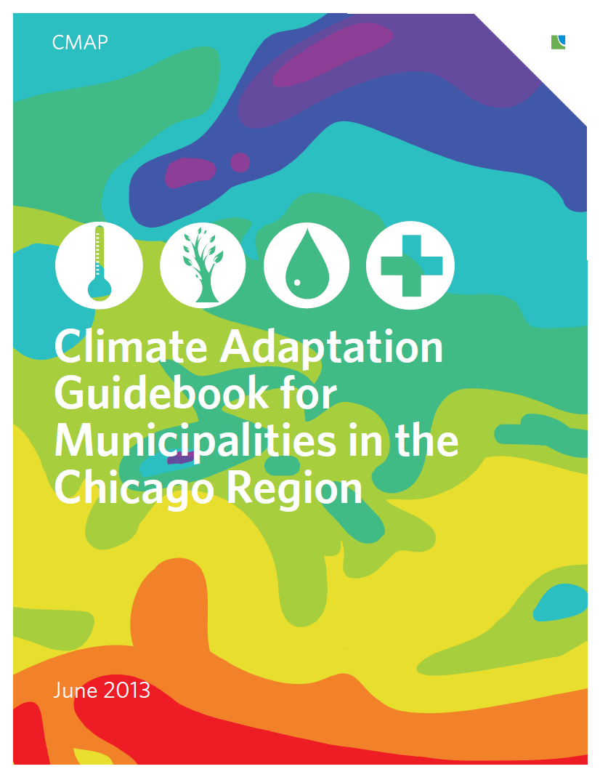
CMAP responses: Climate Adaptation
Climate Adaptation Guidebook
Anticipated regional impacts of more frequent heavy rainfall
  Increased flood damage because area of significant flood risk and elevation of floodwaters are underestimated on flood maps
  Increased downstream flood damage because detention is inadequate
Potential Adaptation Measures
  Increase flood protection elevation.
  Apply floodplain management requirements to area larger than the historic Special Flood Hazard Area.
  Expand outreach and technical assistance to reduce flood risk.
  Develop stormwater master plan to identify needed drainage improvements.
Notes:
(Source: DCEO study Building Successful Food Hubs) … huge unmet demand – over $10 B to be kept in-state if we produced more fruit and veg.

Slide 7
CMAP responses: stormwater management
Stormwater Management Planning (CMAP)
  MacArthur Foundation & Cook County CDBG Disaster Recovery Funding
  Collect, compile, and provide spatial data for local stormwater planning (e.g., topography; floodplains; repetitive loss info; land use and cover, etc.)
  Develop and refine methodology for planning-level stormwater analysis
  Identify opportunities for neighborhood or site scale green stormwater infrastructure projects using spatial data and flowpath modeling
  Not intended to identify specific engineered structural solutions or replace H&H
  Identify regional priority areas with high stormwater mitigation needs
Consistent with renewed regional focus on stormwater management to address recurring damage, disaster recovery, and climate disruption
  National Disaster Resilience Competition (Chicago, Cook, DuPage, State of Illinois)
  Calumet Stormwater Collaborative (MPC)
  Rain Ready (CNT)
Notes:
(Source: DCEO study Building Successful Food Hubs) … huge unmet demand – over $10 B to be kept in-state if we produced more fruit and veg.

Slide 8
Stormwater Management Planning
Integrate stormwater management and resiliency into comprehensive, subarea, corridor, multijurisdictional, and capital improvement plans via LTA program
Better integrate stormwater management into land use and development plans, policies, regulations, and infrastructure investment decisions
Focus on Cook County communities in partnership with MWRD, Cook County Land Bank, Forest Preserve District, and Calumet Stormwater Collaborative
2014 LTA Applicant | Project Type
City of Blue Island | Capital Improvement Plan
Village of Brookfield | Comprehensive Plan
Village of Calumet Park | Planning Priorities Report
Village of Franklin Park | Comprehensive Plan
Village of Richton Park | Capital Improvement Plan
Village of Richton Park | Comprehensive Stormwater Management Plan
Village of South Holland | Comprehensive / Strategic Plan
Notes:
(Source: DCEO study Building Successful Food Hubs) … huge unmet demand – over $10 B to be kept in-state if we produced more fruit and veg.

Slide 9
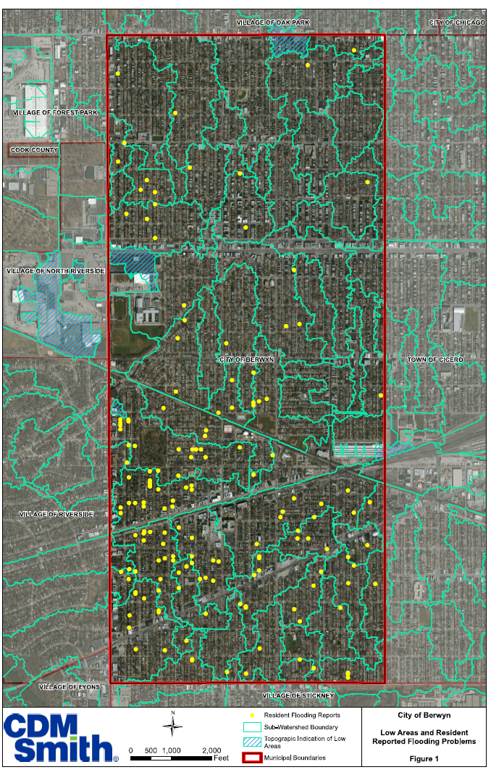
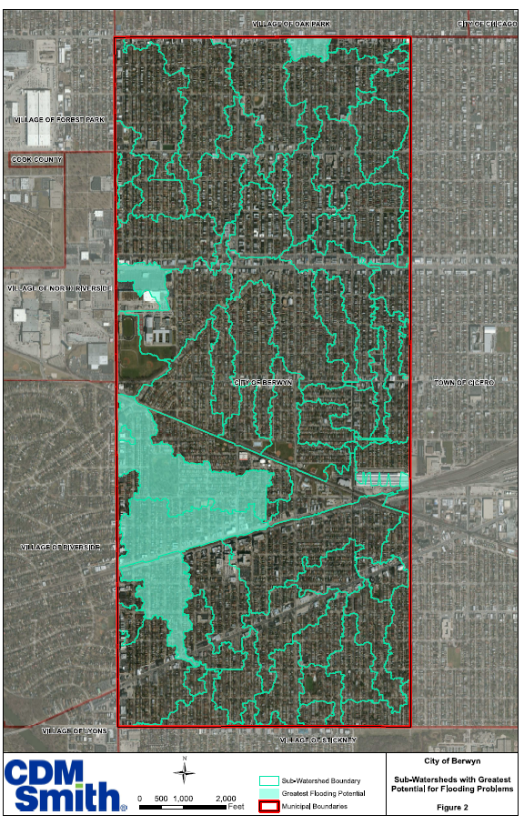
Notes:
(Source: DCEO study Building Successful Food Hubs) … huge unmet demand – over $10 B to be kept in-state if we produced more fruit and veg.

Slide 10
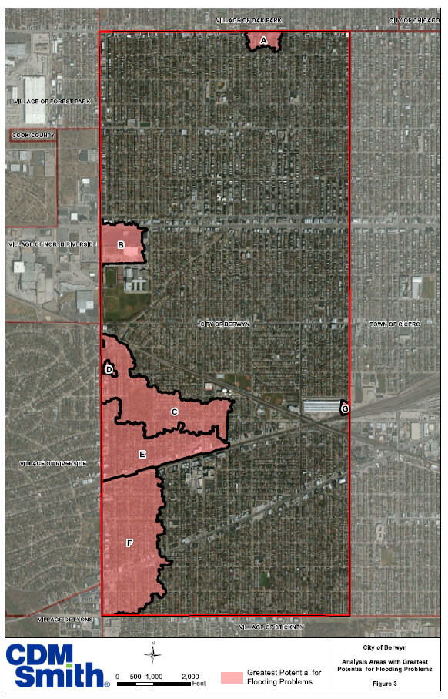
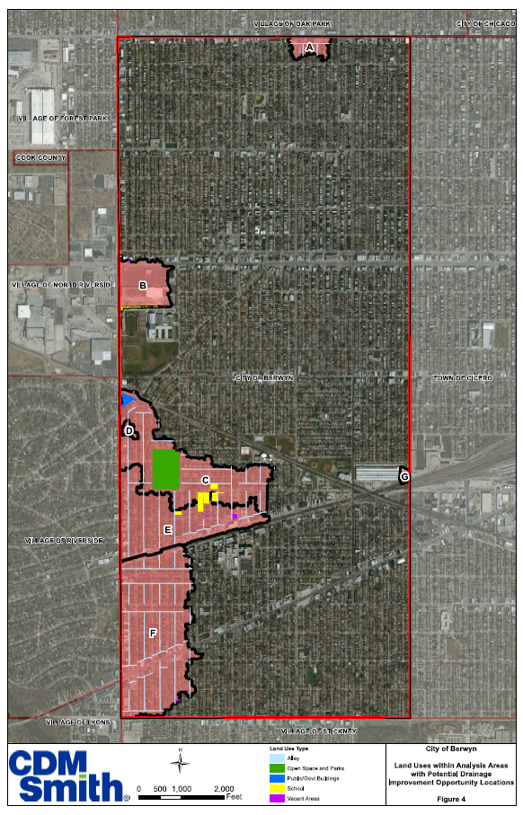
Notes:
(Source: DCEO study Building Successful Food Hubs) … huge unmet demand – over $10 B to be kept in-state if we produced more fruit and veg.

Slide 11
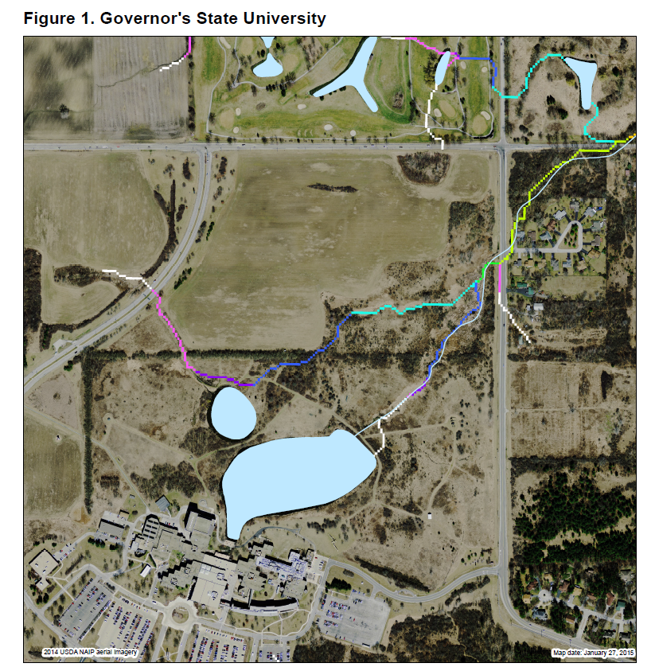
Flowpath Modeling
Notes:
(Source: DCEO study Building Successful Food Hubs) … huge unmet demand – over $10 B to be kept in-state if we produced more fruit and veg.

Slide 12
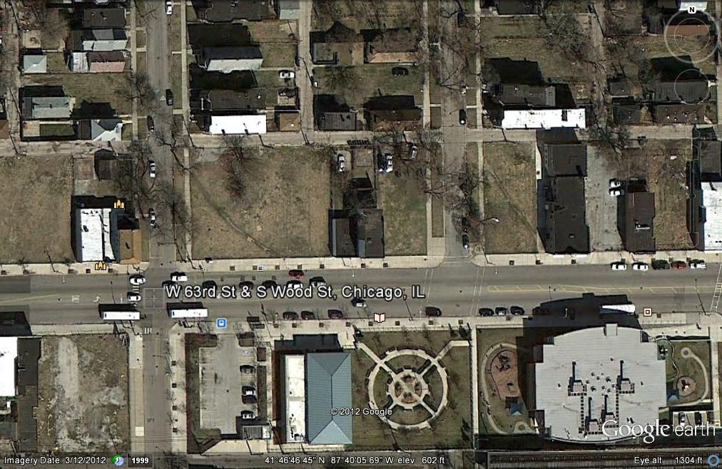
Flowpath Modeling
Source: City of Chicago and Hey Associates
Notes:
(Source: DCEO study Building Successful Food Hubs) … huge unmet demand – over $10 B to be kept in-state if we produced more fruit and veg.

Slide 13
Flowpath Modeling

Slide 14
Questions?

Slide 15
