Slide 1
FY2015 & FY2016–2019
Capital Program Overview
CMAP Transportation Committee
April 17, 2015
Presented by David Kralik
Department Head, Long Range Planning

Slide 2
Modernization Program
Rolling Stock and Positive Train Control (PTC) program
Estimated at over $2.4 billion over the next ten years
Does not address any of Metra’s other asset categories
Assumes funding from a variety of sources ($1.1B)
  Federal Formula Funds
  Fulfillment of the Illinois Jump Start & Jobs Now Bond programs
  RTA State of Good Repair Bonds
  Metra Financing
Additional funding needed and not yet identified ($1.3B)
2

Slide 3
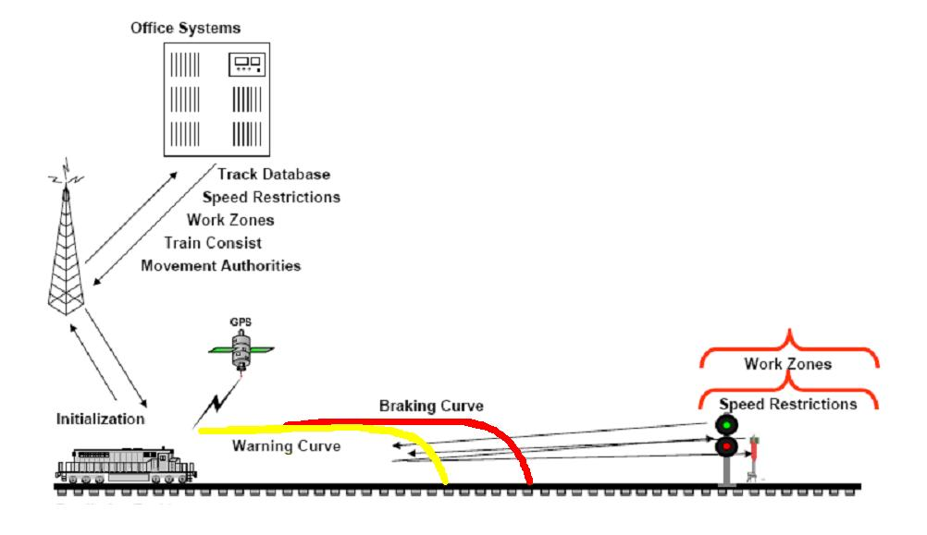
Modernization Program – PTC
The total cost to implement PTC on Metra-controlled lines is anticipated to be over $400 million
3

Slide 4
Modernization Program – Rolling Stock
The total cost to implement the proposed Rolling Stock Program is anticipated to be more than $2.1 billion over a 10-year period
Metra would:
  Purchase 367 new rail cars
  Rehabilitate 455 rail cars
  Increase the number of spare vehicles
  Purchase 52 new locomotives
  Rehabilitate 85 locomotives
  Make improvements to 49th Street Yard
4

Slide 5
Sample 10-year Multi-Source Financing Plan
Sample 10-year Financing Plan in $ millions | Year 2015 | 2016 | 2017 | 2018 | 2019 | Total Years 1-5 | 2020-2024 | Grand Total
Metra Revenue Bond Proceeds (2015,17,19, 22) | $33.4 | $60.2 | $25.7 | $80.7 | $100.0 | $300.0 | $100.0 | $400.0
Illinois State Bond Jump Start | 60.0 | - | - | - | 16.8 | 76.8 | 103.9 | 180.7
2015 RTA state of Good Repair Bonds | 30.0 | - | - | - | - | 30.0 | - | 30.0
Illinois State Bonds - Jobs Now | 42.0 | - | - | - | - | 42.0 | - | 42.0
Federal Formula Funds (Core Program) | 80.0 | 80.0 | 59.0 | 34.0 | 34.0 | 287.0 | 170.0 | 457.0
Additional Funding Needed | - | - | - | 117.3 | 81.2 | 198.5 | 1,115.4 | 1,313.9
Total Funding Needed | $245.4 | $140.2 | $84.7 | $232.0 | $232.0 | $934.3 | $1,489.3 | $2,423.6
5

Slide 6
2015 – 2019: Capital Program Funding
Funding Sources
Federal Base Program | 2015 | 2016-2019 | Total (in millions)
State of Good Repair (5337)/ Formula (5307) | $156.6 | $655.0 | $811.6
Sub–Total Federal Base Program | $156.6 | $655.0 | $811.6
Supplemental
Federal Congestion Mitigation & Air Quality (CMAQ) | 4.0 | 12.8 | 16.8
RTA State of Good Repair Bond | 45.0 | 0.0 | 45.0
RTA Innovation, Coordination, & Enhancement (ICE) | 13.3 | 9.5 | 22.8
Metra Farebox Capital | 10.0 | 40.0 | 50.0
Metra Financing | 100.0 | 200.0 | 300.0
Sub–Total Supplemental Program | $172.3 | $262.3 | $434.6
Core Capital Total | $328.9 | $917.3 | $1246.2
6

Slide 7
Capital Program Summary by Asset Category
Asset Categories | 2015 | 2016-2019 | Total (in $Millions)
Rolling Stock | $92.0 | $430.7 | $522.7
Track & Structure | 36.9 | 148.7 | 185.6
Signal, Electrical & Communication | 131.6 | 158.2 | 289.8
Facilities & Equipment | 44.5 | 70.1 | 114.6
Stations & Parking | 9.4 | 40.8 | 50.2
Support Activities | 14.5 | 68.8 | 83.3
Total | $328.9 | $917.3 | $1,246.2*
* May not total due to rounding
7

Slide 8
Potential Funding Sources
Federal
Long-Term Federal Transportation Legislation
Federal Discretionary Grant Programs
State
Realization of a Funded & Sustained State Bond Program
Additional State Bond Funding beyond 2014
State Capital Improvement Programs
Local
RTA State of Good Repair Bonds
RTA Capital Funding
Metra Financing
Other
8

Slide 10
Metra Financing
Project/Year | 2015 | 2017 | 2019 | Total
Car Rehabilitation | $7.7 | $37.1 | - | $44.8
Locomotive Rehabilitation | 4.3 | 33.6 | - | 37.9
Yard Improvements - 49th Street | 20.0 | - | - | 20.0
New Cars | - | 29.3 | 100.0 | 129.3
Positive Train Control (PTC) | 68.0 | - | - | 68.0
Total | $100.0 | $100.0 | $100.0 | $300.0
Extra 1

Slide 11
Innovation, Coordination, Enhancement (ICE) Funding
Project | 2015
Mobile Application | $3.2 M
Hybrid Vehicles | 1.0 M
Automated Field IT Systems | 3.5 M
Special Events Services | 0.5 M
Passenger Information at Stations | 2.7 M
Metra Crew Calling | 1.8 M
Rock Island Enhancements | 0.7 M
Total | $13.3 M*
* May not total due to rounding
Extra 2

Slide 12
2015 Capital Program - Rolling Stock
PE* | Project Name | Rail Line | Amount (in $Millions)
4507 | LOCOMOTIVE REHABILITATION | MET | 23.0
4910 | CAR REHAB (AMERAIL CARS P6) | MET | 14.0
4901 | TRACTION MOTORS | MET | 1.5
4806 | LOCOMOTIVE MID LIFE REHAB | MET | 11.0
4908 | MU CAR IMPROVEMENTS | MET | 0.5
4906 | CAR REHAB – METRA FINANCING | MET | 7.7
4904 | LOCOMOTIVE REHABILITATION – METRA FINANCING | MET | 4.3
4909 | CAR REHAB (NIPPON SHARYO P-1) | MET | 11.0
4704 | CAR REHAB AMERAIL P5 | MET | 7.0
4711 | HOTEL POWER MODIFICATION | MET | 5.0
4902 | LOCOMOTIVE & CAR IMPROVEMENTS | MET | 1.5
4903 | WHEEL REPLACEMENT | MET | 4.0
4907 | HVAC REFRIGERANT CONVERSION | MET | 1.5
 | Rolling Stock Total |  | $92.0*
* May not total due to rounding
Extra 3

Slide 13
2015 Capital Program - Track & Structure
PE | Project Name | Rail Line | Amount (in $Millions)
2112 | NORTH LINE BRIDGES | UPR | 17.4
4915 | TIES AND BALLAST | BNS | 1.8
4917 | TIES AND BALLAST | MWD | 1.0
4918 | TIES AND BALLAST | RID | 1.0
4919 | TIES AND BALLAST | UPR | 1.0
4912 | TIES AND BALLAST | MED | 2.0
4921 | RAIL GRINDING | MET | .3
4922 | RAIL GRINDING | UPR | .2
4923 | CROSSINGS (ROAD & TRACK) | MET | 2.0
4924 | CROSSINGS (ROAD & TRACK) | MWD | .7
4925 | UNDERCUTTING & SURFACING | MET | .6
4926 | UNDERCUTTING & SURFACING | MWD | .2
Track & Structure Subtotal |  | $28.2*
* May not total due to rounding
Extra 4

Slide 14
2015 Capital Program - Track & Structure (cont.)
PE | Project Name | Rail Line | Amount (in $Millions)
4927 | RAIL | BNS | 1.4
4933 | RAIL | UPR | 4.0
4928 | RAIL REPLACEMENT | MET | 1.0
4920 | RAIL | NCS | .7
4932 | ROW FENCING | MET | .1
4938 | BRIDGE & RETAINING WALL S | BNS | .5
4740 | MIDLOTHIAN EMBANKMENT | RID | 1.0
(subtotal) |  | $ 8.7
subtotal (previous page) |  | $28.2*
Track and Structure Total |  | $38.9*
* May not total due to rounding
Extra 5

Slide 15
2015 Capital Program – Signal, Electrical, Communications
PE* | Project Name | Rail Line | Amount (in $Millions)
4343 | POSITIVE TRAIN CONTROL | MET | 123.0
4744 | PROTECTIVE RELAY REPLACEMENT | MED | 0.4
4950 | RECTIFIER REPLACEMENT | MED | 0.5
4944 | PASSENGER INFORMATION | MET | 2.7
4956 | SIGNAL SYSTEM UPGRADES | MET | 0.5
3337 | LAKE STREET INTERLOCKER | UPR | 1.0
4842 | 16TH STREET SIGNAL | RID | 3.0
4742 | STRAY CURRENT PROTECTION | MED | 0.5
 | Signal, Electrical, Communications Total |  | $131.6*
*May not total due to rounding
Extra 6

Slide 16
2015 Capital Program - Facilities & Equipment
PE | Project Name | Rail Line | Amount (in $Millions)
4972 | YARD IMPROVEMENTS | RID | 20.0
4985 | RIGHT OF WAY EQUIPMENT | MET | 1.0
4968 | EQUIPMENT AND VEHICLES | MET | 2.0
4992 | HYBRID VEHICLES | MET | 1.0
4866 | OFFICE EQUIPMENT | MET | 0.4
4969 | CREW FACILITY | UPR | 0.1
4743 | 547 BLDG IMPROVEMENTS | MET | 0.7
4959 | IT COMPONENTS & SERVICES | MET | 3.0
4852 | FINANCIAL SYSTEM REPLACEMENT | MET | 12.8
4993 | AUTOMATED FIELD IT SYS | MET | 3.5
 | Facilities & Equipment Total |  | $44.5*
* May not total due to rounding
Extra 7

Slide 17
2015 Capital Program – Stations & Parking
PE | Project Name | Rail Line | Amount (in $Millions)
4980 | STATION FACILITY IMPROVEMENTS | MET | $1.5
4967 | ADA IMPROVEMENTS | MET | 1.0
4784 | VAN BUREN STATION | MED | 0.5
4982 | CARY STATION AND SHELTERS | UPR | 2.0
4781 | 115th PARKING & IMPROVEMENTS | RID | 0.9
4995 | PROTECTIVE LAND ACQUISITION | MET | 3.5
 | Stations & Parking Total |  | $9.4*
* May not total due to rounding
Extra 8

Slide 18
2015 Capital Program - Support Activities
PE* | Project Name | Rail Line | Amount (in $Millions)
4796 | LOCALLY FUNDED PROJECTS/MATCH | MET | .8
4990 | WINTERIZATION UPGRADES | MET | 1.0
4998 | PROJECT ADMINISTRATION | MET | .8
4999 | CONTINGENCIES | MET | 1.7
4958 | SPECIAL EVENT SERVICES | MET | .5
4951 | ELECTRONIC CREW CALLING | MET | 1.8
4952 | ROCK ISLAND ENHANCEMENT | MET | .7
4991 | MOBILE APPLICATION | MET | 3.2
4994 | INFRASTRUCTURE ENGINEERING | MET | 3.0
4996 | UNANTICIPATED CAPITAL | MET | 1.0
 | Support Activities Total |  | $14.5*
* May not total due to rounding
Extra 9

