Slide 1
The Will County Community Friendly Freight Mobility Plan
Regional Impacts and Opportunities
CMAP Policy Committee
January 11, 2018

Slide 2
Will County Executive Will County Board Will County Department of Transportation Will County Land Use Department Chicago Metropolitan Agency for Planning Will County Freight Advisory Council Will County Environmental Stakeholder Organizations
Acknowledgements

Slide 3
Key Findings

Slide 4
The Importance of Freight in Will County

Slide 5
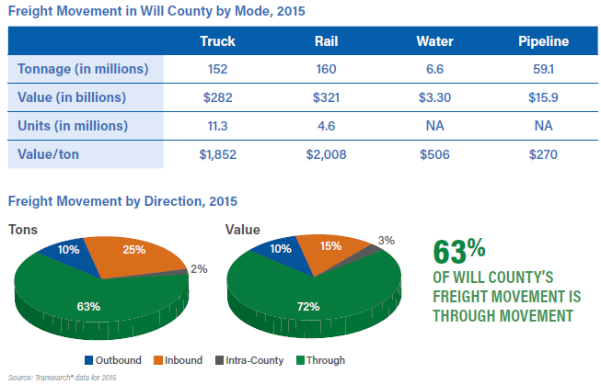
What do Freight Flows in Will County Look Like?

Slide 6
How Important is the Freight Workforce to Will County’s Economy?

Slide 7
Key Findings
Freight is Critical to the Economic Success of Will County.
Will County Freight Movement is Critical to the Northeastern Illinois Region, State and Nation.
Traditional Planning Approaches Cannot Handle the Pace of Freight Development Experienced in Will County.
Freight Volume Growth May Affect Safety and Worsen Existing Bottlenecks and Operational Issues.

Slide 8
Key Findings
Continued Growth Without Planning and New Transportation Investments may Impact Will County’s Economic Competitiveness and Quality of Life.
Funding and Institutional Issues Make it Difficult to Invest in Freight Projects.
Will County Needs Regional, State, and National Funding Support.

Slide 9
Select Analysis

Slide 10
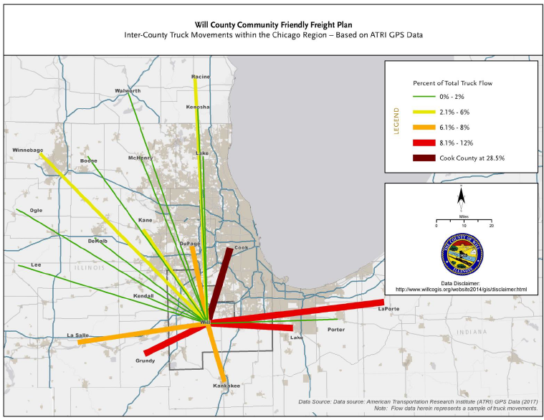
Regional Freight Movements

Slide 11
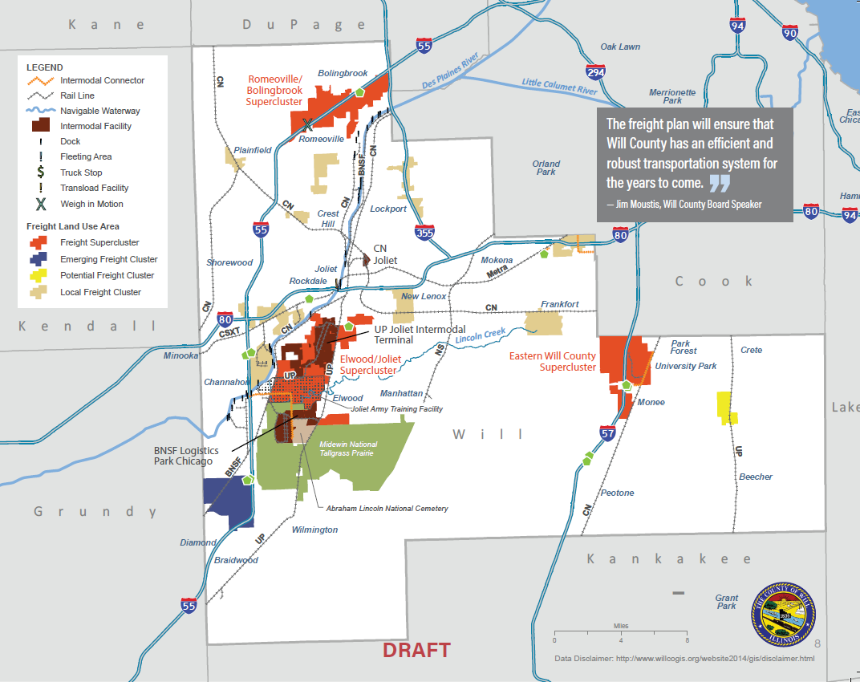
Freight Assets and Clusters

Slide 12
Recommendations

Slide 13
What programs or policies can Will County adopt to improve freight and quality of life?
Implement Investment Priorities identified in the Plan.
Improve coordination of overweight/oversize permitting between Jurisdictions.
Expand data collection and modeling, with focus on freight clusters and corridors.
Expand East-West highway connectivity to reduce traffic on local roads.
Increase air cargo capacity by continuing to support the South Suburban Airport

Slide 14
Plan Recommendations
Develop freight workforce initiatives through partnerships with employers.
Increase workforce mobility to job centers using transit hubs and increased bus service.
Develop and communicate a transparent freight network using designated truck routes.
Coordinate transportation and land use planning throughout the County.

Slide 15
Key Freight Projects

Slide 16
Key Freight Projects
Projects evaluated using:
Preservation Enhancement
Safety
Mobility
Economic Competitiveness
Community Sensitivity
Environmental Sensitivity.
25 out of 91 projects evaluated classified as top tier of critical projects
Critical for improving freight movement and quality of life
Many are of national, state, and regional significance and ripe for federal and state investment

Slide 17
Investments to Improve the National Freight Network
I-80 Add Lanes, Bridge Reconstruction, Interchanges Reconstruction:
Ridge Road to US 30 add lanes
Houbolt Road interchange reconstruction
Des Plaines River bridges and IL 53 interchange reconstruction
Briggs St. interchange reconstruction
US 30 interchange reconstruction
I-55 and I-80 interchange reconstruction
I-55 Add Lanes, Bridge Reconstruction, Interchanges Reconstruction
I-55 from I-80 to Route 129 add lanes
Des Plaines River bridges reconstruction
Lorenzo Road/Route 129 interchanges reconstruction
I-55 and Weber Road interchange reconstruction

Slide 18
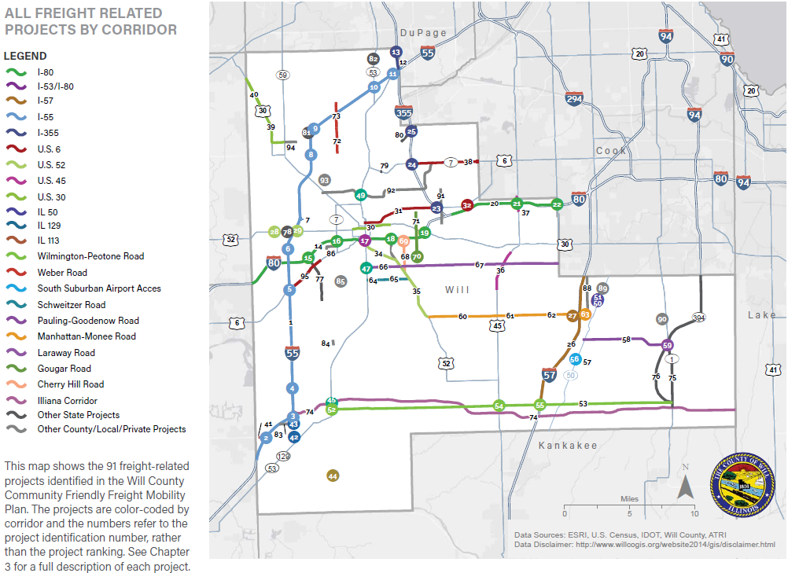
Key Freight Projects
Notes:
Point to larger map. Explain gaps in the map. Thank Board members for their review and input.

Slide 19
Plan Implementation
Notes:
Should note that these are not in the plan, but are a part of implementing the plan

Slide 20
8 Action Categories – 50+ Action Items
Will County Advocacy
Community Collaboration
Creating a Transparent Integrated Truck Route Network
Develop a common oversize/overweight permit application and one-stop online process
Community Resource Center
Provide best practices for freight development, planning and mobility
Private sector led Industry Center
Focus on workforce development, retention and mobility
Intergovernmental Outreach
Land Use Strategy
Project Prioritization Tool
Project Planning, Programming and Implementation
Plan Implementation

Slide 21
www.willcountyfreight.org
More Information

Slide 22
THANK YOU

