Slide 1
Housing Policy Updates: Tracking Housing Change in the Region
CMAP Land Use Committee, March 20, 2013

Slide 2
Housing Policy Updates
Assess housing trends
Compare change to GO TO 2040 Goals
2nd Quarterly blog complete, 3rd will be broken into several
Notes:
CMAP collects a lot of data – this is an effort to leverage that data and use it to assess regional change
identify gaps in our understanding
3) Tracks four major areas – existing home values, for-sale housing starts, Rental development trends, building permit trends
4) I’ll go over some of the blog data as well as info that didn’t make the cut today.

Slide 3
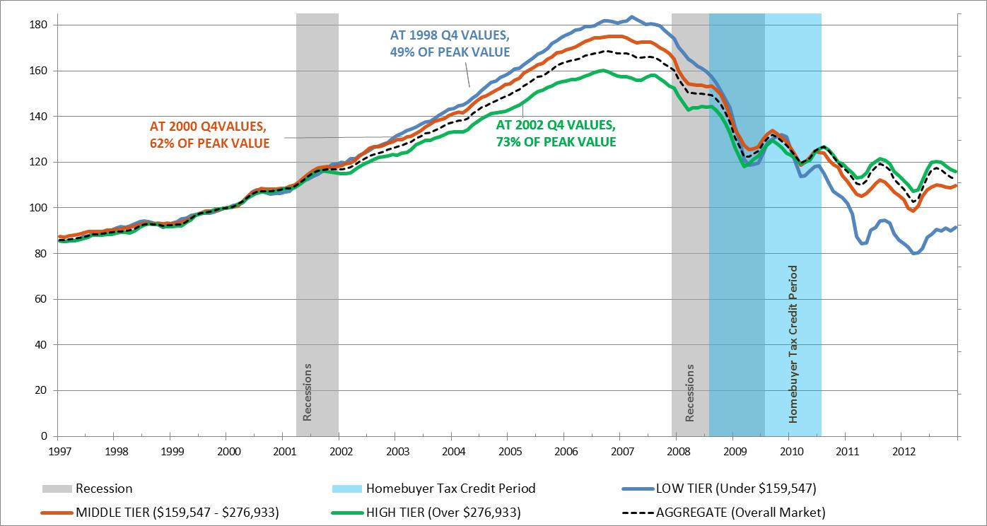
Housing Value Change Remains Unequal Across Sectors
Largest High-Low gap
Source: CMAP Analysis of Standard & Poor’s Case-Shiller Index data
Notes:
Case-shiller index
Home values indexed to 2000, AVERAGE based on same-home sales
Chicago region is lagging the country – 19th in value change in september, 20th in October
Not all bad – the combination of low values and interest rates makes for-sale housing much more affordable than it has historically been.
We have traditionally had smaller peaks and valleys than the rest of the country
Case-shiller continues to show that high-end housing is further along than low and mid-tier
AVERAGE value, not median. So the region’s (and nation’s) index is highly influenced by high-value properties
Month-to-month declines began in September – normal seasonal pattern
The Y-Y decline in the low-tier is slowing, but Chicago and NYC are the only regions in the index that are still experiencing annual decline
We are behind the rest of the country – still in year to year decline. Gains over the summer were strong but not quite enough. Our year to year losses have slowed significantly – 1.5% at the end of Q3. 1.3% in October. We’ve been between negative 1% and 2% for several months. We bottomed in March 2012. May do so again, but it shouldn’t be much of a decline.
ON CLICK - We know this is happening
Gap between the high and low tiers is at its highest level yet. Atlanta and Chicago are the worst in the country. Artifact of predatory lending to low-income buyers and the slower foreclosure process in Illinois. IL foreclosure rate is among the highest in the country @ 6.1%. This may begin to resolve – short sales are up 57% in IL compared to q3 2011. Up 48% from Q2.
Low and moderate-income communities have been impacts from both sides – lower revenues and more abandoned or poorly maintained homes
Housing collaboratives are one strategy
Now for a look at value changes within the region
Similar story to Case-shiller, with more fine-grained detail on the region
C-S is an average – this is median. It’s less weighted by high-value homes.
Single family in the region is generally doing better than condos
McHenry and Kendall are the only counties that show a current positive year-year change in SFH values
McHenry and Lake continue to struggle overall due to low condo values
Condos also a problem in Cook
Ongoing focus of these updates isn’t value- but the implications of the value changes, both internally and as we relate to other

Slide 4
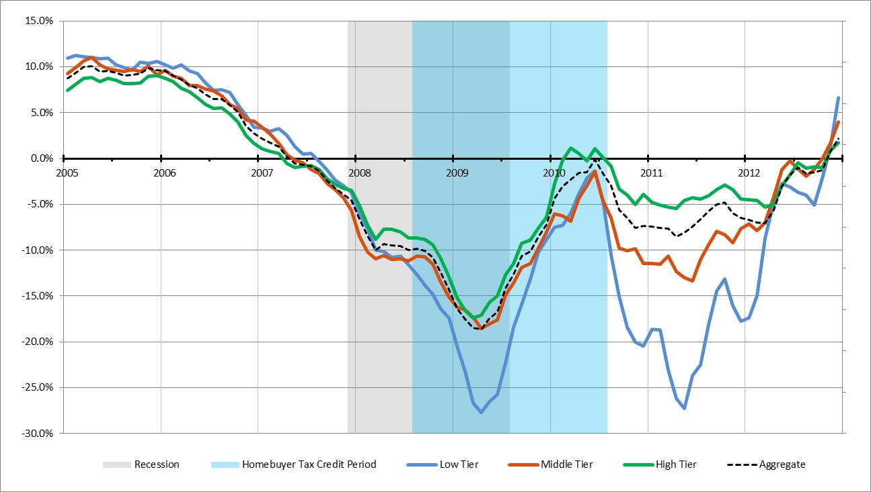
First Year-to-Year Positive Change in the Case-Shiller Index Since April ‘07
Source: CMAP Analysis of Standard & Poor’s Case-Shiller Index data

Slide 5
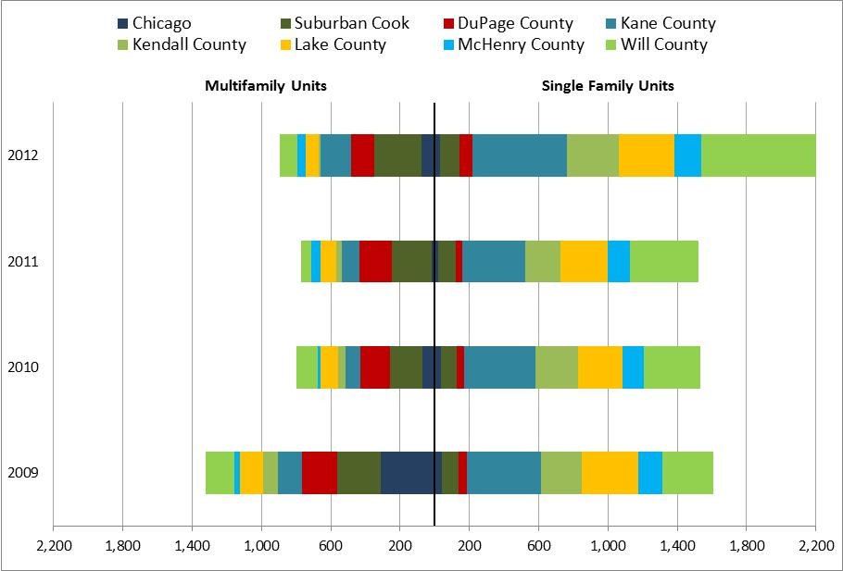
For-Sale Housing Starts Concentrated in SFH
Note: Metrostudy provides data for new housing developments of 10 units or more. Therefore, this analysis does not include smaller developments such as 3 and 4-unit condo buildings, single-lot infill, or custom homes. This may lead to lower start totals in the city of Chicago and inner ring suburbs that are built out and experience mostly infill development with smaller projects.
Source: CMAP analysis of Metrostudy data
Notes:
Info on starts will be brief – Metrostudy presents this data to housing committee on a quarterly basis
NOTE ON THIS DATA - Metrostudy doesn’t track infill, but focuses on developments with at least 10 units. This misses a lot of infill and small projects, and, therefore, these numbers tell a slightly different story than building permits. We are working on strategies to find starts infill data. Both for-sale and for-rent.
For-sale starts show a trend toward single family
Most new multifamily is rental, so numbers here are low. News indicates that small projects are moving forward in select locations, but large developments are not. Some projects are being built without a designation of for-rent or for sale, so MF for-sale starts could see some sudden spikes depending on economic conditions.
SFH starts have increased over other post-recession years, but are currently at about 10% of pre-recession highs
Nearly 31% of SFH starts are in Will, its highest proportion since 2005. Kane is next with 22% of starts. Kendall and Lake are third, ~15% each.
Stock of Finished vacant units has declined, so starts are coming back up.
Will county has the largest stock of SFH, about 5 months supply at current rates
Chicago has the largest stock of MFH - nearly 2 years supply at current rates. Some of these are currently rented but kept on the books as for-sale because that is the developer’s final intent. This quarter marks the first time that the Finished vacant stock has increased in Chicago since 2008. New units are under construction!
Long term problem is the Vacant developed lots
Have some infrastructure in place, but no unit started. Some are within mostly-developed subdivisions, while others have zero or few units.
The region has about 31,000 SFH VDL and 15,000 MFA VDL
Largest stock is in Will County, with 13,000 SFH VDL, Chicago has 1,500 MFA VDL, Suburban Cook has 2,100 MFA VDL
Region is working through the attached housing VDL stock faster than SFH. MFA VDL have declined about 25% from a 2007 peak, and SFH has declined about 15% from a 2008 peak.
Some of these subdivisions may present a long term problem and may stay in their current state for a number of years – they may be poorly located, need significant infrastructure, or to be replatted and redesigned, which is very high cost.

Slide 6
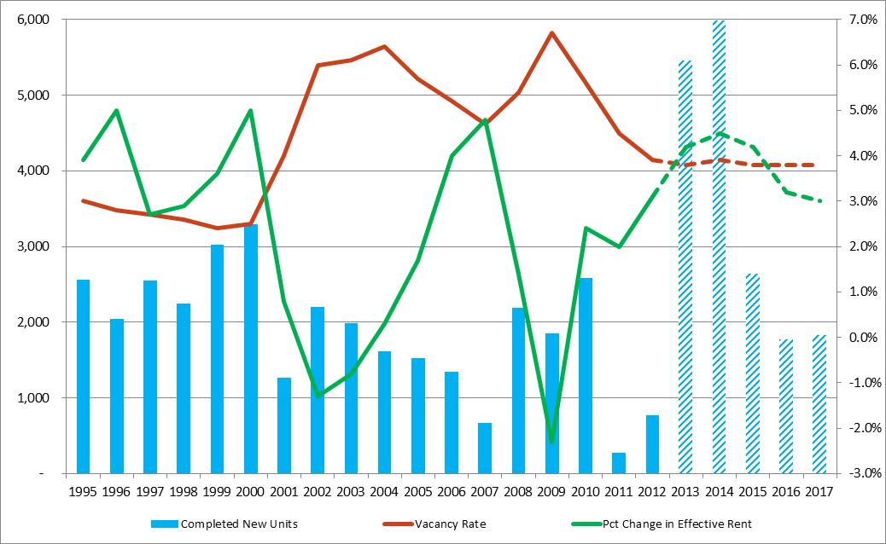
Rising Rents, Falling Vacancy, and New Units Under Construction
Source: CMAP analysis of Reis apartment market data.
Note: Reis provides data on rental developments of 40 units or more. Therefore, smaller and infill developments may not be tracked in this dataset.
Notes:
This data is provided by Reis, inc. It tracks developments with more than 40 units. Vacancy rates here are likely to be lower than the full regional housing stock, and monthly rent is likely to be a bit higher.
Not many new rental units delivered in 2012, BUT there is quite a lot under construction.
This delay reflects the longer construction timelines for multifamily buildings
A lot of the 2008/2009 and even some 2010 developments were condo buildings converted to rental
Vacancy rates continue to fall – particularly in suburban areas.
Regional vacancy is down to 3.9%, from 4.4% in January of 2012
Projected to stay stable for the next several years
Again, some of the largest changes have been in suburban markets – Top 5 are City West, Glen Ellyn/Wheaton, East Lake County, Glendale Heights/Lombard and Joliet.
Lowest vacancy rates are near downtown Chicago
Rents have increased nearly 3.2% As compared to Q4 of 2011
Effective rents increases in western and northern suburban areas have been matching city of Chicago increases
Largest increase in Lincoln Park = 5.3%, Next in Evanston/Glenview at 5%, Oak Park at 4.2% and O’Hare at 4.1%, Glen Ellyn/Wheaton and South Shore at 3.6%

Slide 7
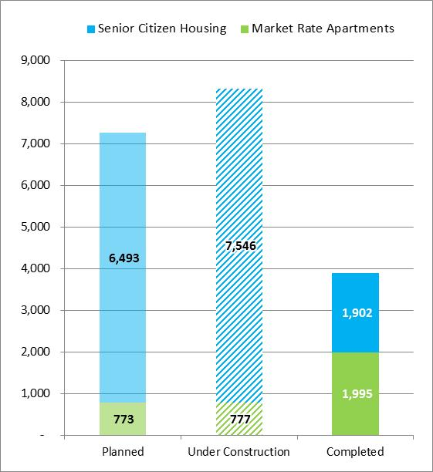
Senior and Market Rate Units Under Construction
CMAP Region Rental Unit Pipeline, 2012 Q4
Source: CMAP analysis of Axiometrics and Reis apartment market data.
Note: Planned developments have received permits and have a construction start date.
Notes:
Most of these are in the City of Chicago
Nearly 7,200 units are under construction, 5,500 of which are in Chicago.
The ratio is reversed for the 1,300 completed and 800 under-construction senior housing units. Eighty percent of the completed senior units and 70 percent of the under-construction units are in suburban areas
Q3 permits have bucked this trend, but will that continue?

Slide 8
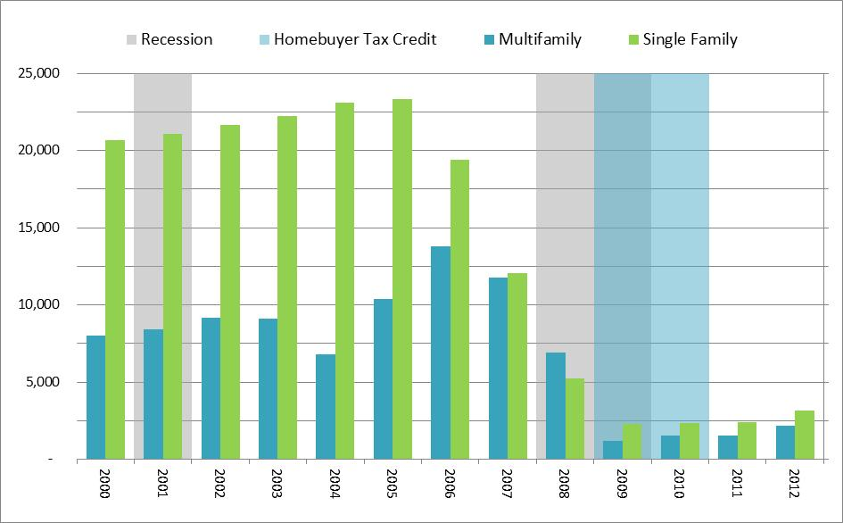
Building Permits Continue to Rise
Source: CMAP analysis U.S. Census building permit data.
Notes:
We track building permits because they provide a more complete picture of all units – rather than the development size threshold for commercial datasets
BPs don’t differentiate between for-rent and for-sale
This chart shows only the first three quarters of each year
Building permits are coming back up this year – still at about 13% of average
On a quarterly basis, single family is above every post-recession year
Multifamily is above all, but is highly variable and the fourth quarter may change its overall proportions for the year
Most permitted units are built (FILL IN %s). It takes a few months for a single family home, and up to two years for multifamily units
Let’s take a closer look at the region

Slide 9
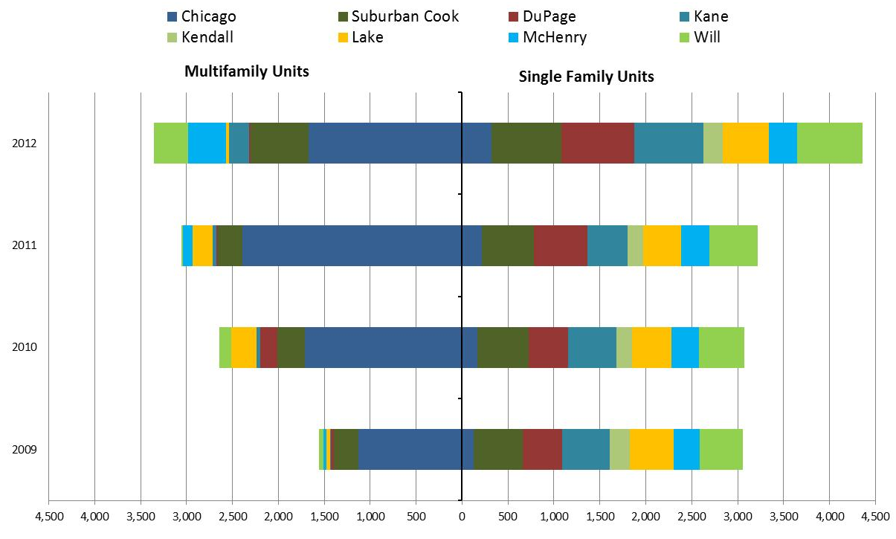
A Shift in Permit Locations
CMAP Region Annual Permitted Residential Units by Year, Type and Location
Source: CMAP analysis U.S. Census building permit data.
Notes:
This chart shows first half only
Dominance of SFH over the last several years
Visible recovery in the collar counties this year – see this in the numbers and the news. Villages are starting to remove fee breaks, other incentives meant to make housing development less expensive.
Multifamily is up, too. According to other data sources, it’s mostly rental.
Concentrating in Chicago and Cook
Many barriers to rental
Unproven market
Access to financing
Local opposition
Lack of zoning/long entitlement process

Slide 10
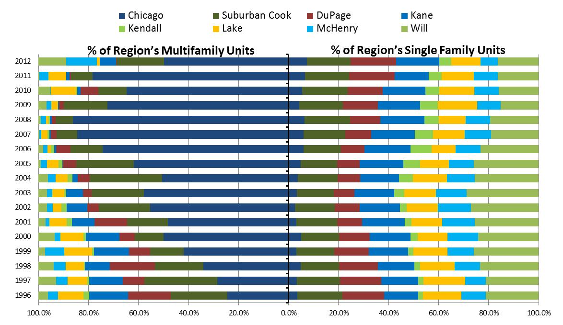
Annual Proportion of Permitted Units by Type and Location
Source: CMAP Analysis of US Census Building Permit Data
Notes:
Multifamily decreasing in the suburbs and increasing in the Chicago – Except this quarter. Explain the 5 developments that went online.
SFH on the increase percentage-wise
Note issues:
Census tracking does not get 100% of multifamily units (particularly low-income, but there is also the “illegal unit problem”)
However, the trend is problematic – most MFH is in Chicago, at the same time that the population is aging and Millennials are looking for their own homes. As a region, we need to provide more housing options for people at all stages of life – in the suburbs, too.
Talk about trend line – Chicago, suburban Cook and DuPage are currently grabbing a larger share of SFH than they historically have, Outer county MFH this year so far is much higher than normal. Both of these could be a trend or they could be a blip.
Talk about rental options – acs trends on slow increase of SFH rental, ~30,000 more SFH for-rent units over the last decade, but lost about 70,000 rental MFH over the same time period. TH rental made up the gap.

Slide 11
Annual Single Family Permits
Source: CMAP Analysis of U.S. Census building permit data

Slide 12
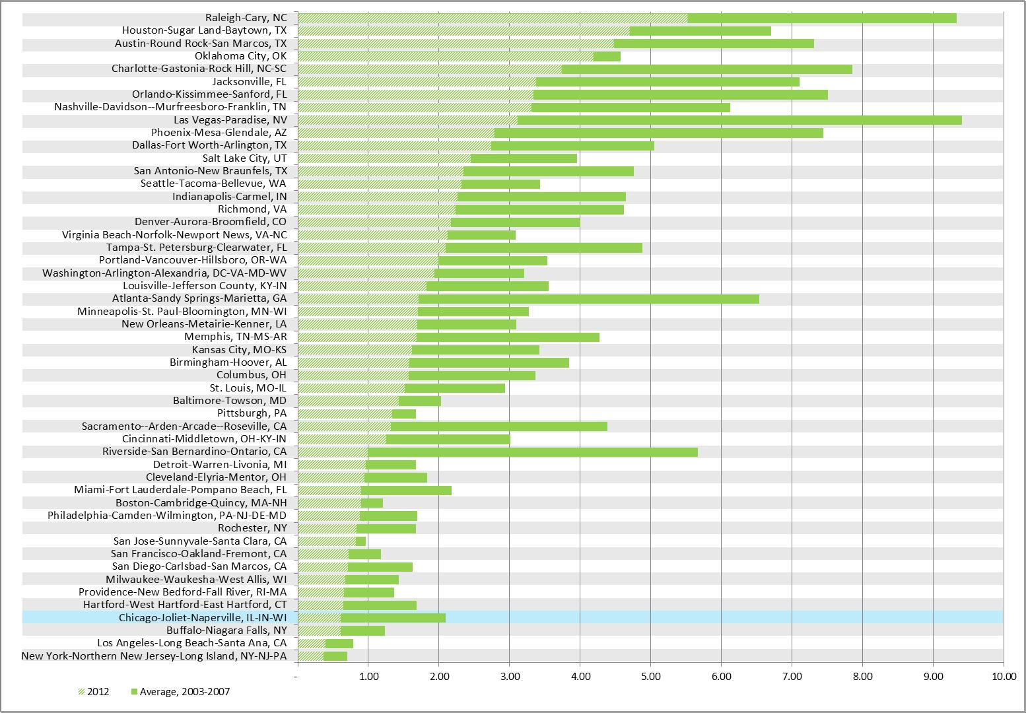
Single family permits below average in all MSAs
Single Family Residential Permits per 1,000 People in MSAs with more than 1 Million Residents
Source: CMAP Analysis of U.S. Census building permit data
Source: CMAP Analysis of U.S. Census building permit data
Notes:
EXPLAIN THE COLORS/BARS
Major shakeup of most active metros for multifamily – most of the top are fast-growing
Fastest growing metros are at the top.
Chicago’s average rank is 41 (median 35). Best is 17 in 2007. Worst is 50th in 2009.
Some of the reason for the lag is our plethora of “other” rental options
Failed condo projects that are now rental, as well as individual for-rent units
Increasing rental of single family – about 30,000 units
However, we’re behind. Other MSAs are exceeding their historic avgs, while we are at a fraction of ours
WHY?
Unemployment – our rate is higher than many other metros. Impacts household formation, migration
Demographics – We have strong growth in the senior population, a growing multifamily demographic. BUT, our population of 25 to 29 year olds only grew by 1% between 2000 and 2010. Our population of 30 to 34 year-olds fell by nearly 7%. Nationally, 25-29 years olds increased by almost 9%, and 30 to 34 year olds decreased by a lesser 2.7%. Demographically, we’re attracting or retaining less of a key demographic for new housing – multifamily or detached.

Slide 13
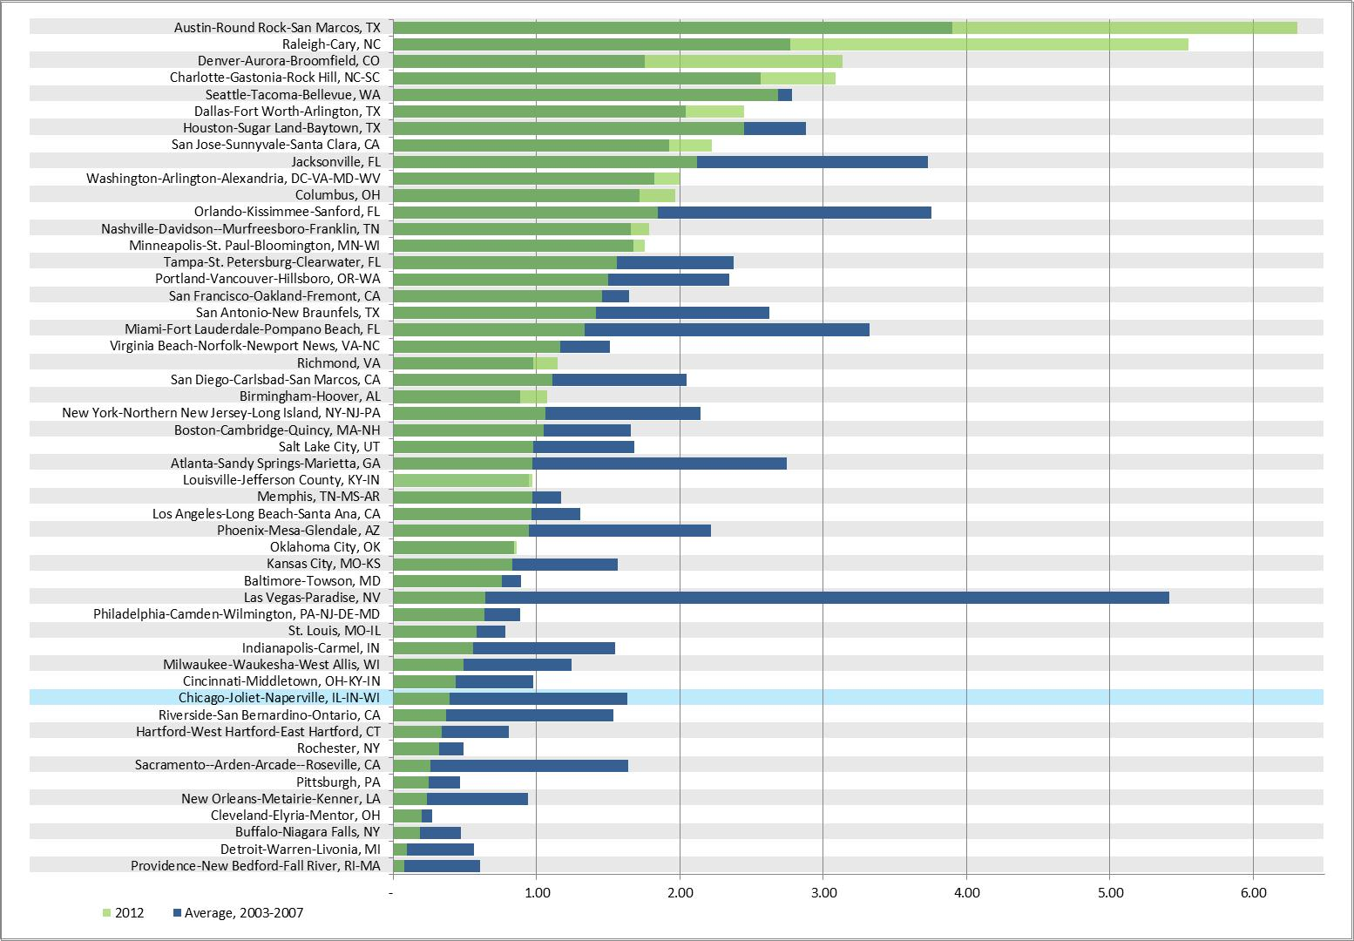
Fast-Growing MSAs exceeding historic multi-family permitting averages
Multi-family Residential Permits per 1,000 People in MSAs with more than 1 Million Residents
Source: CMAP Analysis of U.S. Census building permit data
Notes:
EXPLAIN THE BARS
NOTE: Averages are 2004 to present – they represent the boom
No region has exceeded its pre-recession per-person productivity, although some are getting closer to their “normal” this year.
Chicago MSA’s average Q2 rank is 41 (median 39). best was 34 in 2006 and 2007, lowest was 49, 2010 to 2012
Larger MSAs are generally near the bottom, but we are lower than we have been historically.

Slide 14
Takeaways
Housing values have begun to increase on an annual basis
The gap between the recovery in high-value and low-value homes is troubling, but declined from its peak in July
Monthly rents are on the rise and vacancy rates are falling, with the biggest changes in suburban markets
Housing starts and residential permits are on the rise
Chicago, Suburban Cook and DuPage County continue to gain an increasing share of single family permits, possibly due to historic infill patterns
2012 saw an atypically high proportion of multifamily permits in suburban areas, driven by 3rd quarter permits

Slide 15
Next Steps
Split single quarterly blog into two to three separate blogs released over several weeks
Provide more in-depth discussion of related policy and legislative issues
Continue to work to expand resources related to infill development

Slide 16
Questions?
http://www.cmap.illinois.gov/policy-updates
Elizabeth Schuh
Senior Policy Analyst
312-386-8681
Email: eschuh@cmap.illinois.gov

