Slide 1
Relationships between Infrastructure Cost and Regional Growth Patterns
August 19, 2009

Slide 2
Background and purpose
Developing scenarios for GO TO 2040 Plan
Different strategies have different costs associated with them
May also see cost savings – we undertook study to determine whether growth patterns influence infrastructure costs
Literature: more compact forms of development generally lead to reduced cost of infrastructure per household
Made preliminary estimates of the infrastructure needed to support growth in each scenario:
Local roads
Wastewater
Drinking water (in progress)

Slide 3
Density and local road mileage

Slide 4
Change in local road mileage by scenario
Base year: 28,286 miles of local roads in region
Scenario | Total Local Road Miles | Change from Reference | Percent change from Reference
Reference | 34,431 | 0 | 0%
Reinvest | 32,333 | -2,098.39 | -6.49%
Preserve | 33,583 | -848.40 | -2.46%
Innovate | 34,431 | 0 | 0%

Slide 5
Wastewater
The cost of the collection system decreases with the compactness of new development.
There will be essentially no cost to construct collection systems (aside from service connections) during redevelopment because the sewer system already exists.
The cost of providing treatment varies with the location of growth: development in areas with adequate treatment capacity will not require the expansion of wastewater treatment plants.

Slide 6
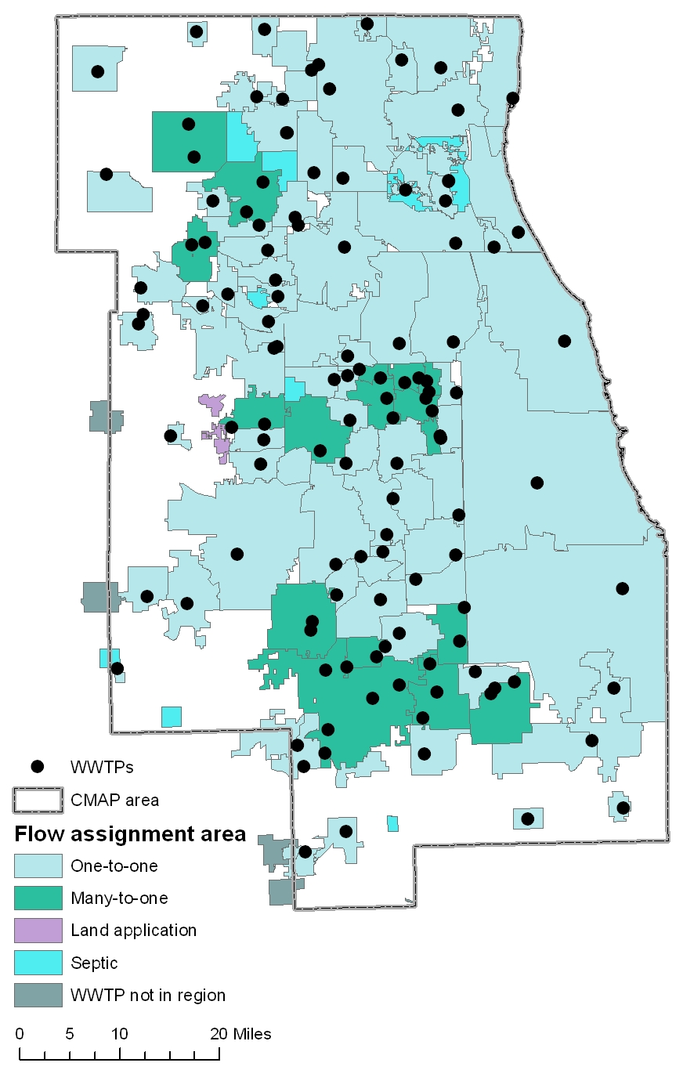
Plant service areas
Plant capacity

Slide 7
New wastewater capacity needed by 2040
System component | Reference | Reinvest | Preserve | Innovate
Treatment capacity (mgd) | 64.1 | 40.3 | 59.2 | 64.1
Collection (mi) | 4,032 | 2,780 | 3,450 | 2,814
Interceptors (mi) | 163 | 104 | 171 | 61
Pump stations (no.) | 328 | 226 | 280 | 229

Slide 8
Preliminary savings estimates (millions)
Capital | Reinvest | Preserve | Innovate
Roads | $11,462 | $4,634 | TBD
Wastewater | $725 | $235 | $358
Drinking water | TBD | TBD | TBD
O&M (cumulative)
Roads | $341 | $138 | TBD
Wastewater | $200 | $45 | $133
Drinking water | TBD | TBD | TBD

Slide 9
Questions/Comments
Jesse Elam
(312) 386-8688
jelam@cmap.illinois.gov

