Slide 1
NE Illinois Regional Permitting
Advisory Committee Update
Chicago Metropolitan Agency for Planning
Nick Vlahos
October 23, 2015
with assistance from

Slide 2
Overview for Today
Main topics to cover
Quickly review project scope
Activities to date
What has worked and what has not
What is coming up, and how you can help
Important things to discuss – 14 major observations
Very small municipal and county volumes compared to IDOT volumes mean less daily focus
Most approvals are manual and procedural, often intuitive
The person that owns the data owns the permitting process
Technology is being embraced, now how to leverage it?
There is strong stakeholder interest in building uniform experiences for everybody, while preserving autonomy

Slide 3
Cambridge Systematics’ Team for RFP 127
Prime contractor
Expertise in OSOW Process Analysis and Systems
OSOW is part of a broader national freight operations and planning practice, which is part of a broader international transportation practice
Active in Northeastern Illinois freight projects
Northeastern Illinois firm with deep understanding of stakeholder outreach and freight issues
Assist in stakeholder outreach, vision/requirements setting, case studies
Northeastern Illinois firm focused on transportation consulting and data analytics
Mix of public-sector and freight/supply-chain clients
Assisting later in the project with geospatial analysis and industry-related outreach

Slide 4
Defining “Local” Governments
Counties
Responsible for permit issuance on county-owned roads
Receive notifications from IDOT’s online system about permittees with a potential move somewhere within the county
Municipalities
Responsible for permit issuance on roads not owned by the state or county, within incorporated areas
May also enforce permitting laws on county- and state-owned highways running through the municipality
Townships
Skeleton staff responsible for permit issuance on roads in unincorporated areas not owned by the state/county

Slide 5
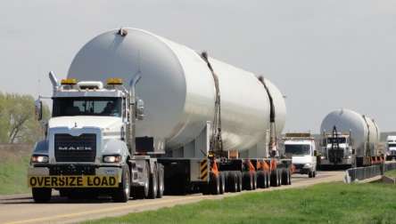
Local Permitting Challenge
What: Need for informed consensus on a “system” of technology, process of policy for local permitting
Why?
Broad role of truck permitting on a number of key regional industries, including but not limited to construction and energy
Growth of industry over past 20 years, expected future growth
Challenges of nearly 300 governmental units in NE Illinois to have coordinated processes and technologies for permitting
Ranges of size of municipality (plus counties, IDOT, Tollway)
Ranges of relative impact of truck permitting flows on agencies’ network
Frequent needs for circuitous paths for OSOW loads
Consistent with national discussions (“harmonization”)
Move from reactive to proactive posture

Slide 6
Three Challenges in Leveraging Innovation
Resources
Local governments tend to have far fewer staff than statewide permitting agencies (0-2 FTE vs. 6-10 FTE)
Costs of technology become harder to distribute over volume
Complexity
Different types of communities – bedroom suburbs vs. industrially-focused, suburban vs. rural, large vs. small, etc.
Data
More technology means the need for more authoritative data with higher degrees of accuracy and faster refresh rates

Slide 7
Local Agencies are Part of the Supply Chain Whether they like it, or not….
Local agencies affect the parts of the supply chain that utilize OSOW movements – some NE Illinois examples:
Building a new hotel
Operating a factory to make consumer dairy products
Recycling parts from inoperative energy equipment
Government’s own construction products
Commodity export
Agencies are involved due to the obligation to manage safety and monitor the infrastructure
Doing OSOW permitting well helps these sectors of the economy operate more effectively.
Obstacles create more obstacles…

Slide 8
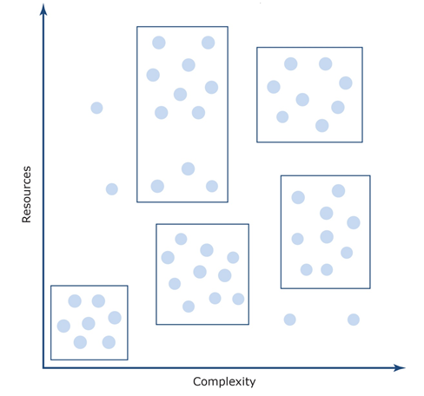
Balancing Complexity and Resources
Identify natural clusters of governments with similar challenges
Some technologies may work for all clusters, some may not
A preferred alternative is likely to be a suite of process, technology, and governance actions organized by relevance to each cluster

Slide 9
Organization of Project Activities
Ongoing Throughout Project
Stakeholder Outreach (Task 1)
Project Management
Sequential Process and Consensus Tasks
Analysis of Current Conditions (Task 2)
Vision and Goal Setting (Task 3)
Alternatives Analysis (Task 4)
Preferred Alternative Selection (Task 5)
Action Plan (Task 6)

Slide 10
Our Approach to Gathering Information
We realize that large-scale, impersonal, surveys to people who rarely think about truck permitting is unlikely to yield much in the way of meaningful results
Instead…
Individual meetings with each county and each high-volume permit agency
Groups of meetings with municipalities
Attempt to get industry and enforcement to join these meetings
Additional meetings with industry to fill in gaps
Specific industries or geographic locations
Feed these results into a broader interactive forum and experience design session to build a shared regional vision for local permitting

Slide 11
What Has Worked, and What Has Not Worked
What has worked well
One-on-one county interviews (6 complete, 7th [Will] on 10/26)
Eight group-based municipal meetings across the region
We have met with approximately 30 municipalities
One more session to be scheduled for south of I-80, early November
What has been occasionally challenging
Finding municipalities to participate
Finding somebody at the municipalities who knows what truck permitting is and who does it
Getting enough lead time to get carriers to join the municipalities
Data – what is it, where is it?
What has been delayed by mutual consent
Meeting with the City of Chicago (To do by 11/13)
Benchmarking against other metro areas (Under way, finish 11/30)
Gathering detailed data from a broad set of municipalities

Slide 12
A (Slightly Contrived) Example of How Complicated Local Permitting Can Be
Let us presume we are trying to move an excavator
A simple trip to drive:
Origin: A construction project in Oakbrook Terrace
Destination: An industrial park in Willow Springs
Route:
Primarily on IL-38, IL-83, 83rd Street/German Church Road
“Last mile” on either end
Six permits possibly needed

Slide 13
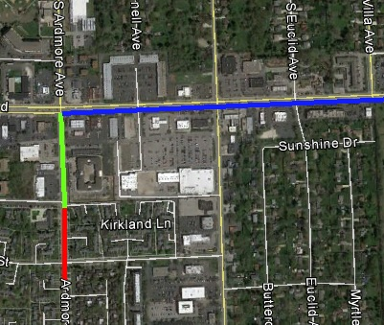
What? Six Permits???
The first couple of blocks requires two permits
York Township (unincorporated) (#1)
Oakbrook Terrace (#2)
The main trip is an IDOT permit (IL-38 to IL-83 to 83rd Street) (#3)

Slide 14
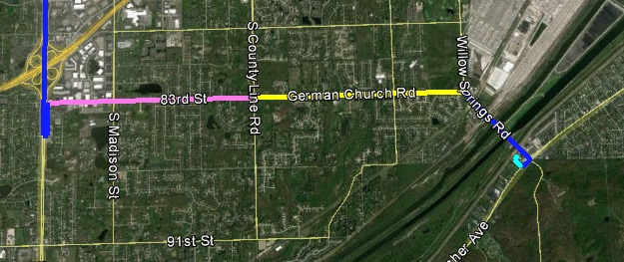
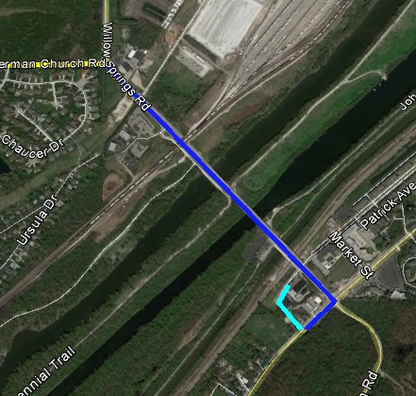
Let’s Buy Some More Permits…
83rd Street in Burr Ridge is a municipal road while in DuPage County (#4)
Then it becomes German Church Road in Cook County, and is county highway B41 (#5)
The little jog over the river and onto Archer Avenue is part of the IDOT permit
Then the last couple of blocks in Willow Springs are a local permit (#6)

Slide 15
Questions About our Hypothetical Move
How do I figure out which jurisdictions I crossed?
How do I know if they even issue OSOW permits?
Am I going to apply for a permit for ½ block?
How long is it going to take me to apply for the permits and get them back?
What happens if I get all but one of them in time?

Slide 16
Major Observations to Date (1-3)
Hierarchy of Permit Volumes – Clusters of agencies
IDOT: 250-400 per day (one per minute)
Busier counties: 30-40 per day (4-5 per hour)
Slower counties and very busy municipalities: 1-2 per hour
Busy municipalities: 1-2 per day
Most municipalities: 1-2 per week
Everybody else: either 1-2 per month, or no ordinance
Thus, very minimal staffing beyond IDOT, rarely > 0.7 FTE
The vast majority of municipal permits would be “auto-issued” by IDOT if those roads were state roads
Very few bridges to cross (weight) or go under (height)
IDOT would then have relevant data that is difficult for municipalities to collect and maintain
Areas where municipal staff use intuition would be coded as travel restrictions

Slide 17
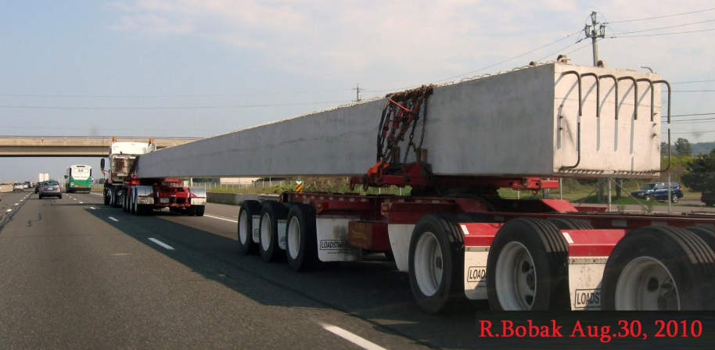
Major Observations (4-8)
Different departments issue municipal permits
Police, public works, engineering, finance
The person who owns the data has to own the permitting process
But what happens when nobody owns the data?
Most loads off the IDOT network are 4-7 axle
A surprising number of municipalities do not have ordinances, including some which attended focus groups
Not limited to the tiny municipalities (Elgin)
Generally time consuming to find out how (/if) a municipality issues permits
Often took our analyst 4-5 conversations

Slide 18
Major Observations (9-12)
Interviewees had a strong desire for a uniform permit application (in terms of data) across the region
Interviewees had a strong desire that IDOT define which municipalities are crossed on local roads and that they are notified the same way counties are now being notified
Not a blanket approach, tailored analysis
Most permit fees of agencies we interviewed are at levels that are realistic and within industry norms
Several interviewees expressed a desire for model ordinances
What process to follow
How much is fair to charge (if anything)
What restrictions to put on approved permits

Slide 19
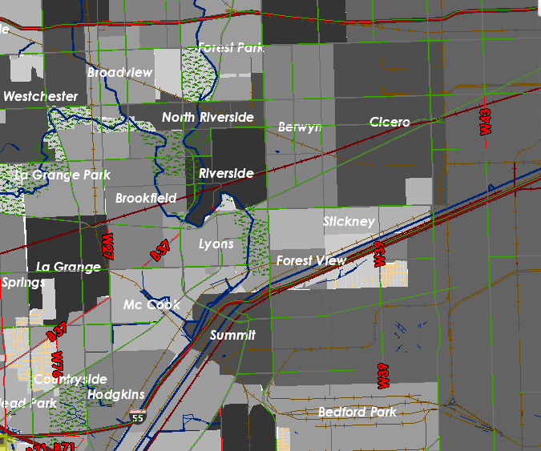
Major Observations (13-14)
“Automation” means different things to different people
Submission of the permit application
Notification to review the permit application
Process integrates engineering analysis
Electronic delivery (email/PDF instead of fax)
Computer makes all decisions on its own
Data for carriers to utilize is difficult to get in the first place, and dispersed when you do identify it
Posted route clearance maps, for example, are not uniformly available at the county level
Unnumbered state jurisdiction roads (common in the region)

Slide 20
Moving Forward – Developing a Regional Vision for Truck Permitting
We want to promote a collaborative approach to develop a shared vison: industry, counties, municipalities, and state agencies
A vision needs to build consistency into a carrier’s business process
Delay fines at a job site can easily exceed $1000/hour
Baseline standards are needed for core activities
Ordinances
Contact information
Fee structures
Service level agreements – in both directions
These are all areas where states have been improving across the last twenty years, as they generally have more financial incentive to do so

Slide 21
A Shared Vision Gives Everybody A Plan for Moving Forward
It affects every stakeholder
IDOT needs to understand what to include into its mission for automation, data management, and outreach
Higher volume local governments need to understand what is expected of them when it comes to automation
Lower volume local governments need to understand what are the basics they have to provide, and how they can provide exceptional service
Carriers and Shippers need to know what their obligations are to keep agencies involved in the supply chain
We need to balance
Immediate corrective actions (3-6 months)
Longer-range strategic actions (1-4 years)
Limitations of resources and divided focus

Slide 22
Moving Into 2016 – A Shared Vision Workshop
We want to follow many of the processes which made GOTO 2040 so successful
We want to prepare everybody to be able to articulate a shared vision so that we can build action plans
The CS team will set up the structure of the vision and the key elements to discuss… but participants have to buy into the decisions to be made
Timeframe for a regional visioning workshop
Preparation: November-December
Execution: mid-January

Slide 23
Tell Us What You Think The Vision Needs to Have
How big should the group be? [25 people? 40?]
Who are the invitees? Industry, government, other?
Duration? [2/3 day?]
Format: We envision a mix of presentations, keypad response, facilitated breakout groups, and open discussion
Result: Elements of what we want truck permitting to look like in Northeastern Illinois in a way that
Maintains infrastructure
Promotes safety
Stimulates the economy

Slide 24
What the CS Team has to do Until the Workshop
Finish the lagging interviews, especially industry
Attempt to collect some additional structured data to support the workshop
Plan the vision workshop
Logistics (date/location)
Session layouts, formats, and technologies
Goals for each session
Presentation materials and speaker notes
Recruit participants – in this room and beyond

Slide 25
Where We Go After the Workshop
Developing action plans for each cluster of local government
Self-assessment guides
Functional requirements for future local automation
Examples of existing ordinances
Guidance on fee structures
Best practices for the various processes that come together in local permitting
Communications and outreach materials
Working together to recommend preferred alternatives for how to move forward in both time frames
3-6 month actions to establish momentum
1-4 year actions to stimulate and innovate

Slide 26
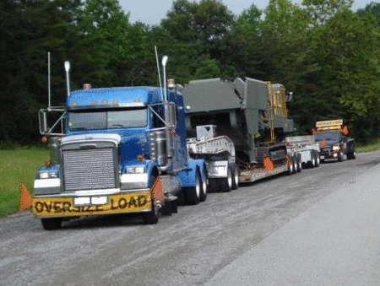
Additional Q & A

